Slide 1
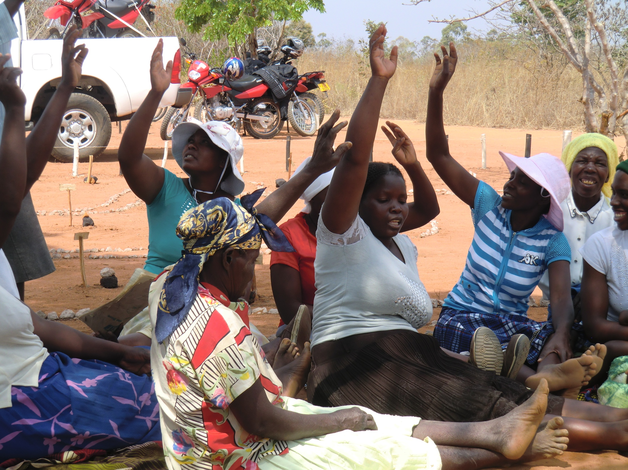
Making Community Led Sanitation work with Community Health Clubs
Presented by
Dr. Juliet Waterkeyn 28th January, 2016
CEO, Africa AHEAD SuSanA Webinar

Slide 2
Objectives of the CHC Zimbabwe Programme:
Blanket coverage of all households in aCHC
Higher CHC targets than ever before:
Community Led: Every house hold having a CHC member
Total Sanitation: all households having safe sanitation
Zero Open Defecation (ZOD) was adopted as the slogan.
It means the same as ODF except it is easier to sing
ZOD means:
Open defecation free (no faeces on the ground)
Latrine to be properly covered toilet (Flies cannot enter)
Or VIP with functional ventpipe (gauze to trap flies exit)

Slide 3
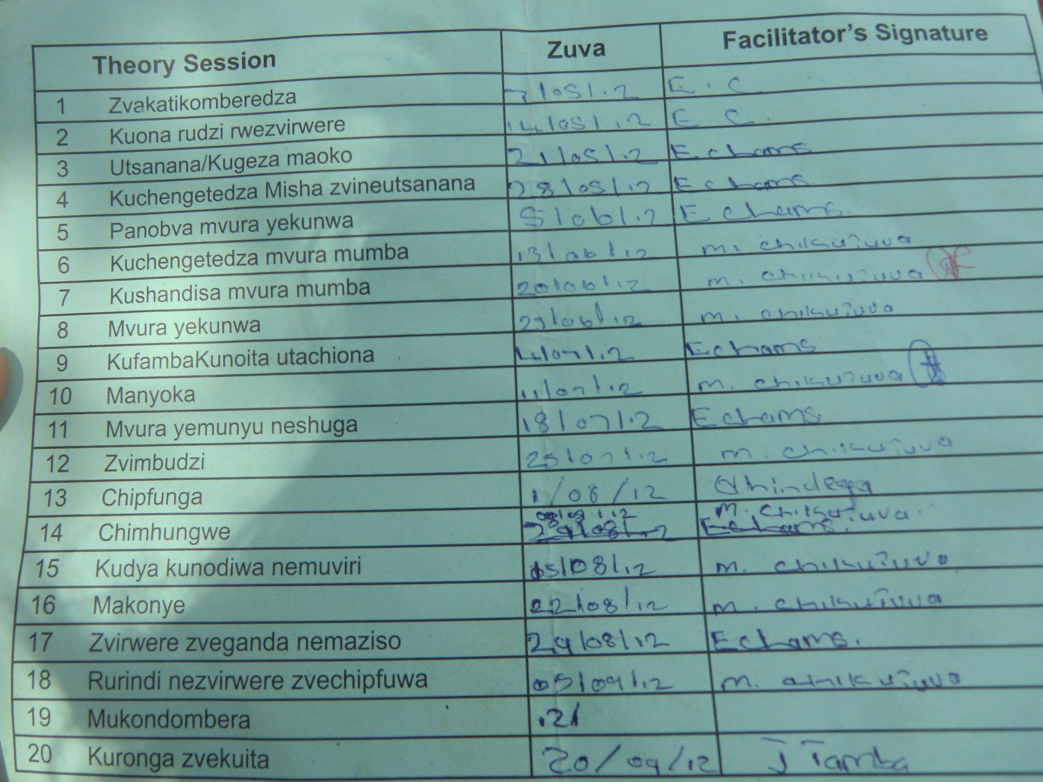
20 topics: one per session for six months with ‘homework’

Slide 4
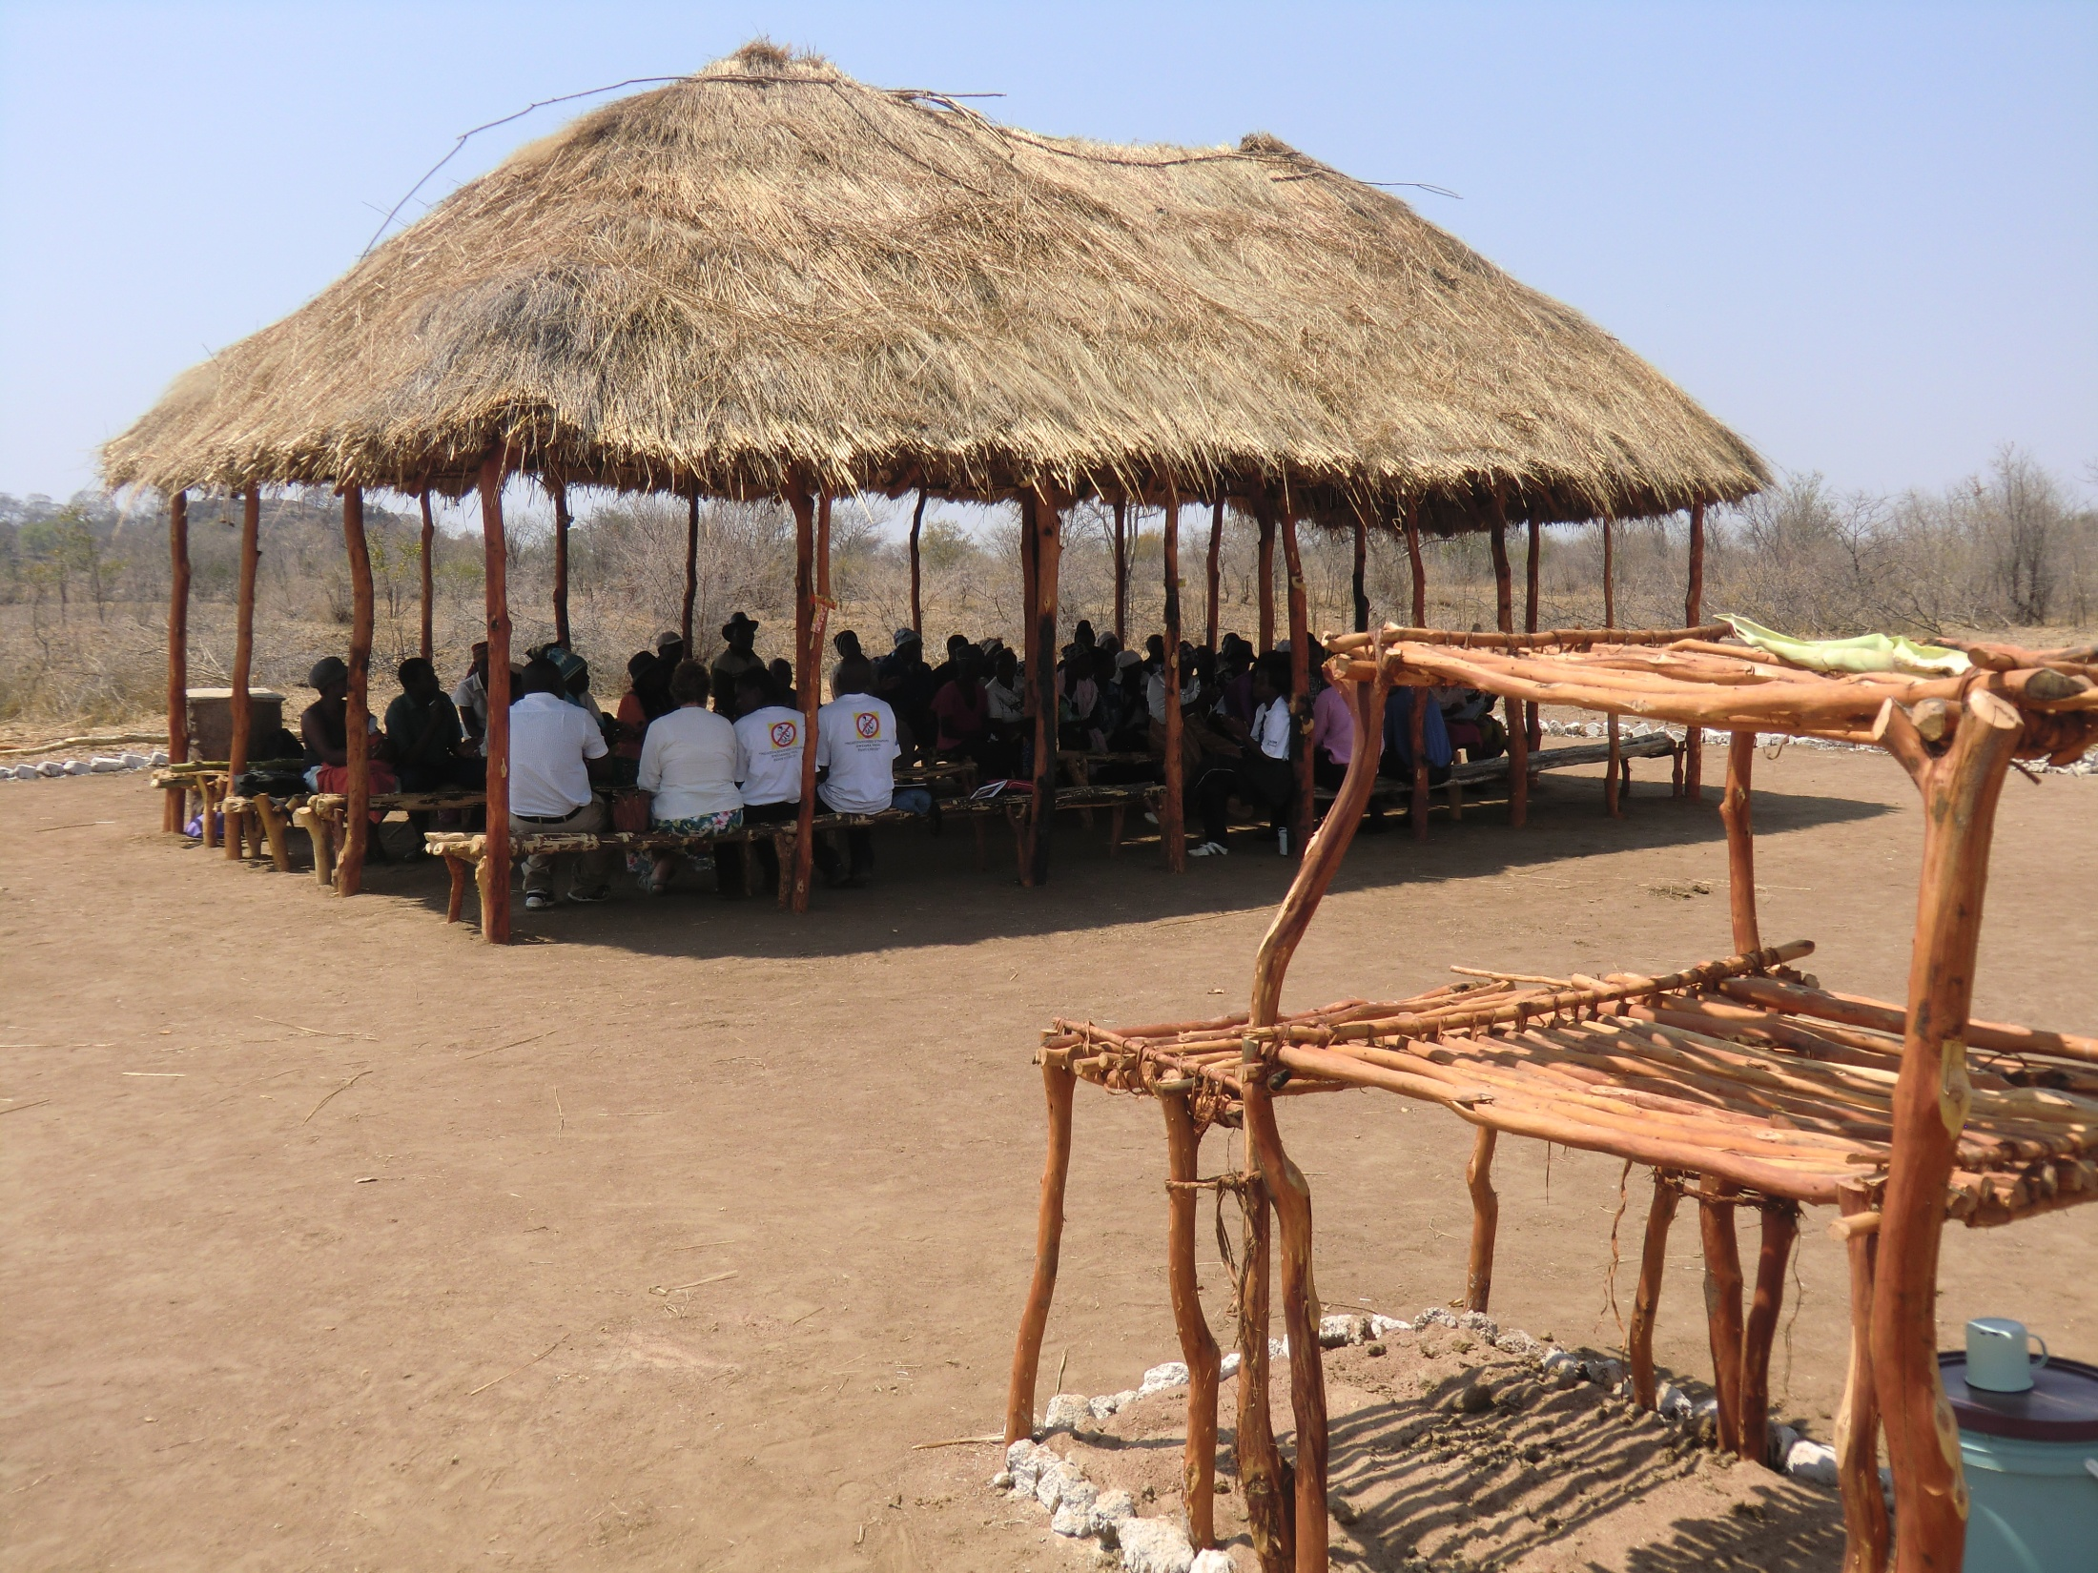
The Meeting Place constructed entirely by the community to ensure CHC meetings can be held in comfort.
A demonstration pot rack is constructed at every CHC Venue

Slide 5
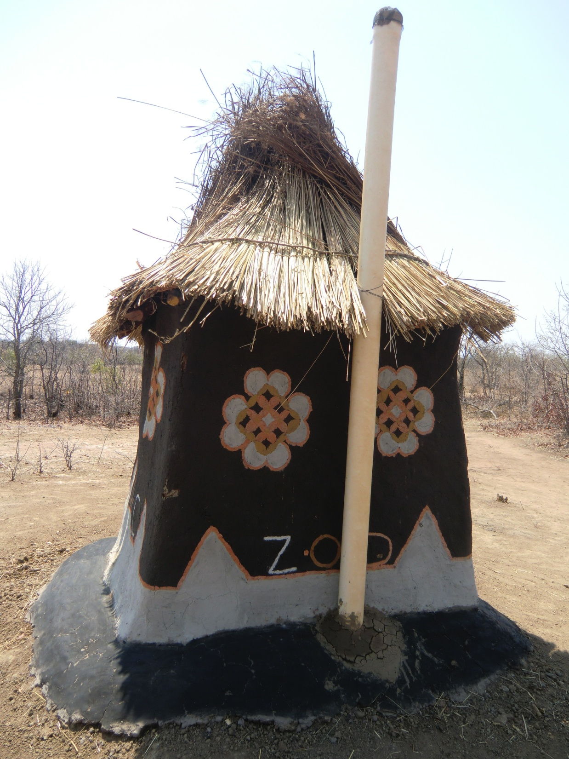
The ZOD latrine
at the CHC
Meeting Place
Community designed
Community built
Community used
No external inputs

Slide 6
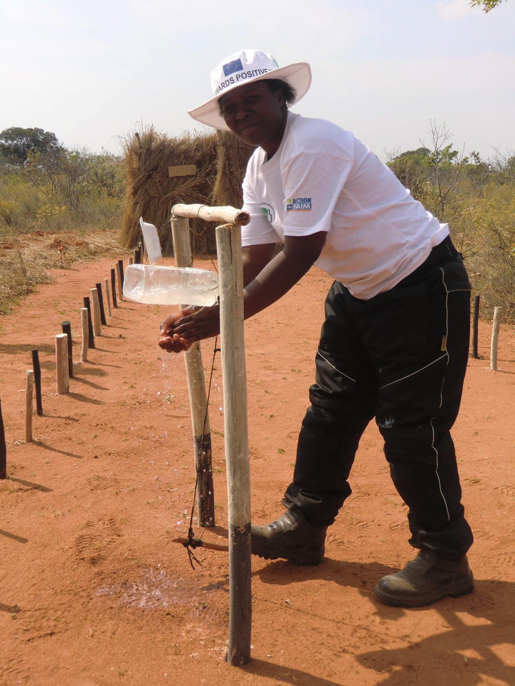
A demonstration Tippy Tap is built at all venues
All members have a least one Tippy tap at home
All members have a pot rack
All members have a rubbish pit
All members have a wash shelter

Slide 7
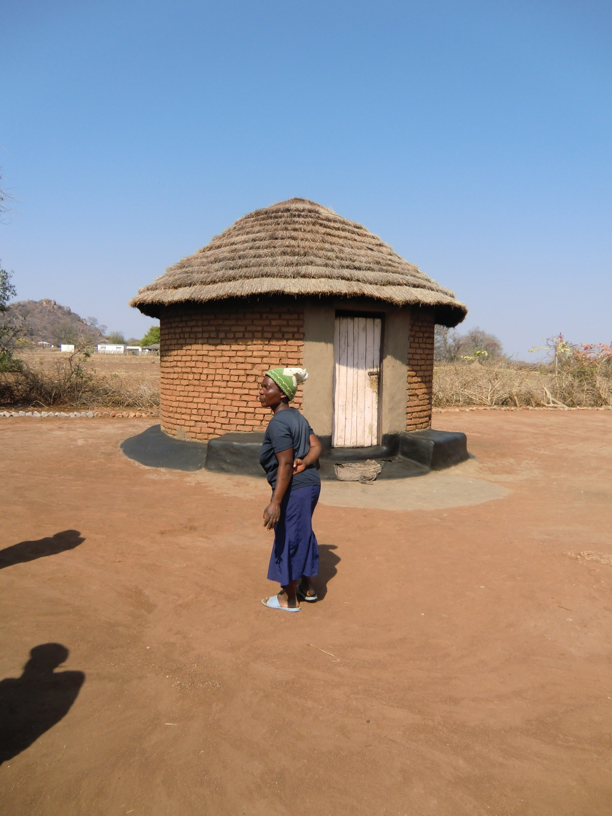
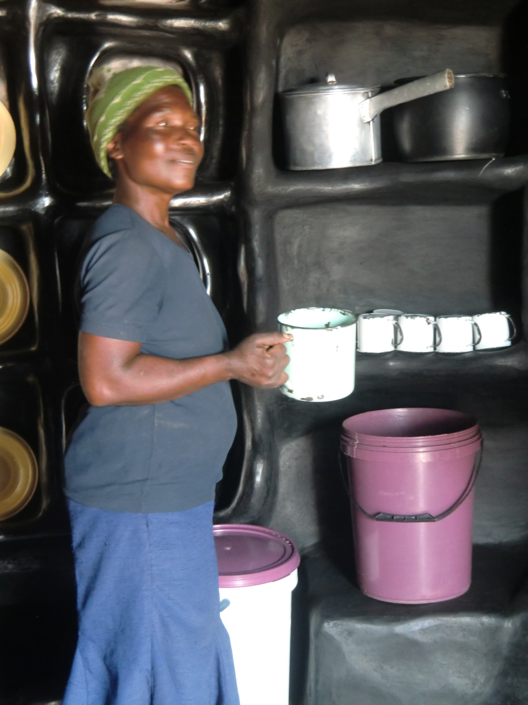
Model Home Competitions
stimulate high standards
The Kitchen seen from the outside
Inside the kitchen
Safe storage
of kitchen utensils
Good food hygiene
Safe Water Storage
Swept yards
and
no open defecation

Slide 8
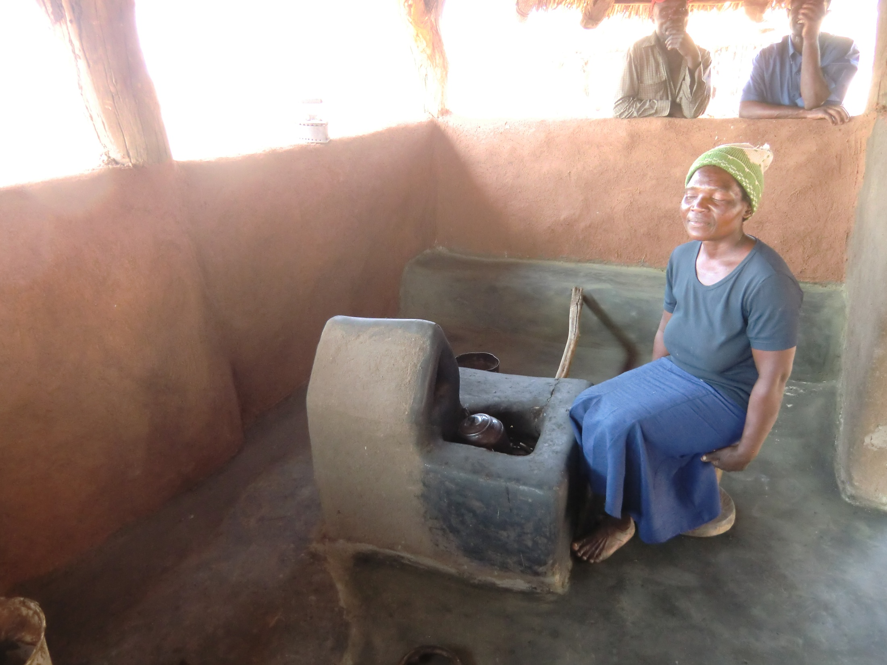
Fuel efficient stoves are encouraged to protect the environment

Slide 9
After only 4 months: Blanket coverage over 11 wards:
More CHC members than households
Districts | Wards | Villages | h/holds | H/hs CHCs | CBFs | CHCs | Members | Committee | Ward Pop | CHC population
Gutu | 5 | 192 | 8274 | 6640 | 70 | 214 | 7963 | 214 | 34339 | 27996
Mberen | 6 | 237 | 7,981 | 7,221 | 84 | 240 | 9,366 | 240 | 46,525 | 40,164
Total | 11 | 429 | 16,255 | 13,861 | 154 | 454 | 17,329 | 454 | 80,864 | 68,160

Slide 10
CURRENT DEBATE BETWEEN TWO MAIN APPROACHES
CHC Approach: Implementation strategy
CLTS Approach (ZimCATS)
Implementation strategy
• 6 months Hygiene sessions
20 sessions (each week)
One ‘Triggering’ day +
a few follow-up visits
• Learning good practice through fun participatory activities reinforced by song, drama
Village walk to shock community that they are eating their own faeces
• Informed group decision making and weekly homework
• Community shamed into action
• Voluntary household improvements / support
Leaders enforce change with fines / punishment
Zero Open Defecation (ZOD) & 20+ other hygiene improvements

Slide 11
Observed Indicators of Sanitation and Hygiene between
CLTS and CHC villages in Zimbabwe
p<0.001
2011.Whaley & Webster

Slide 12
Acknowledgements: Ministry of Health, Zimbabwe
Africa AHEAD Team on the ground in Mberengwa and Gutu (2012)
ACF partner in the programme / EU Funded

