Slide 1
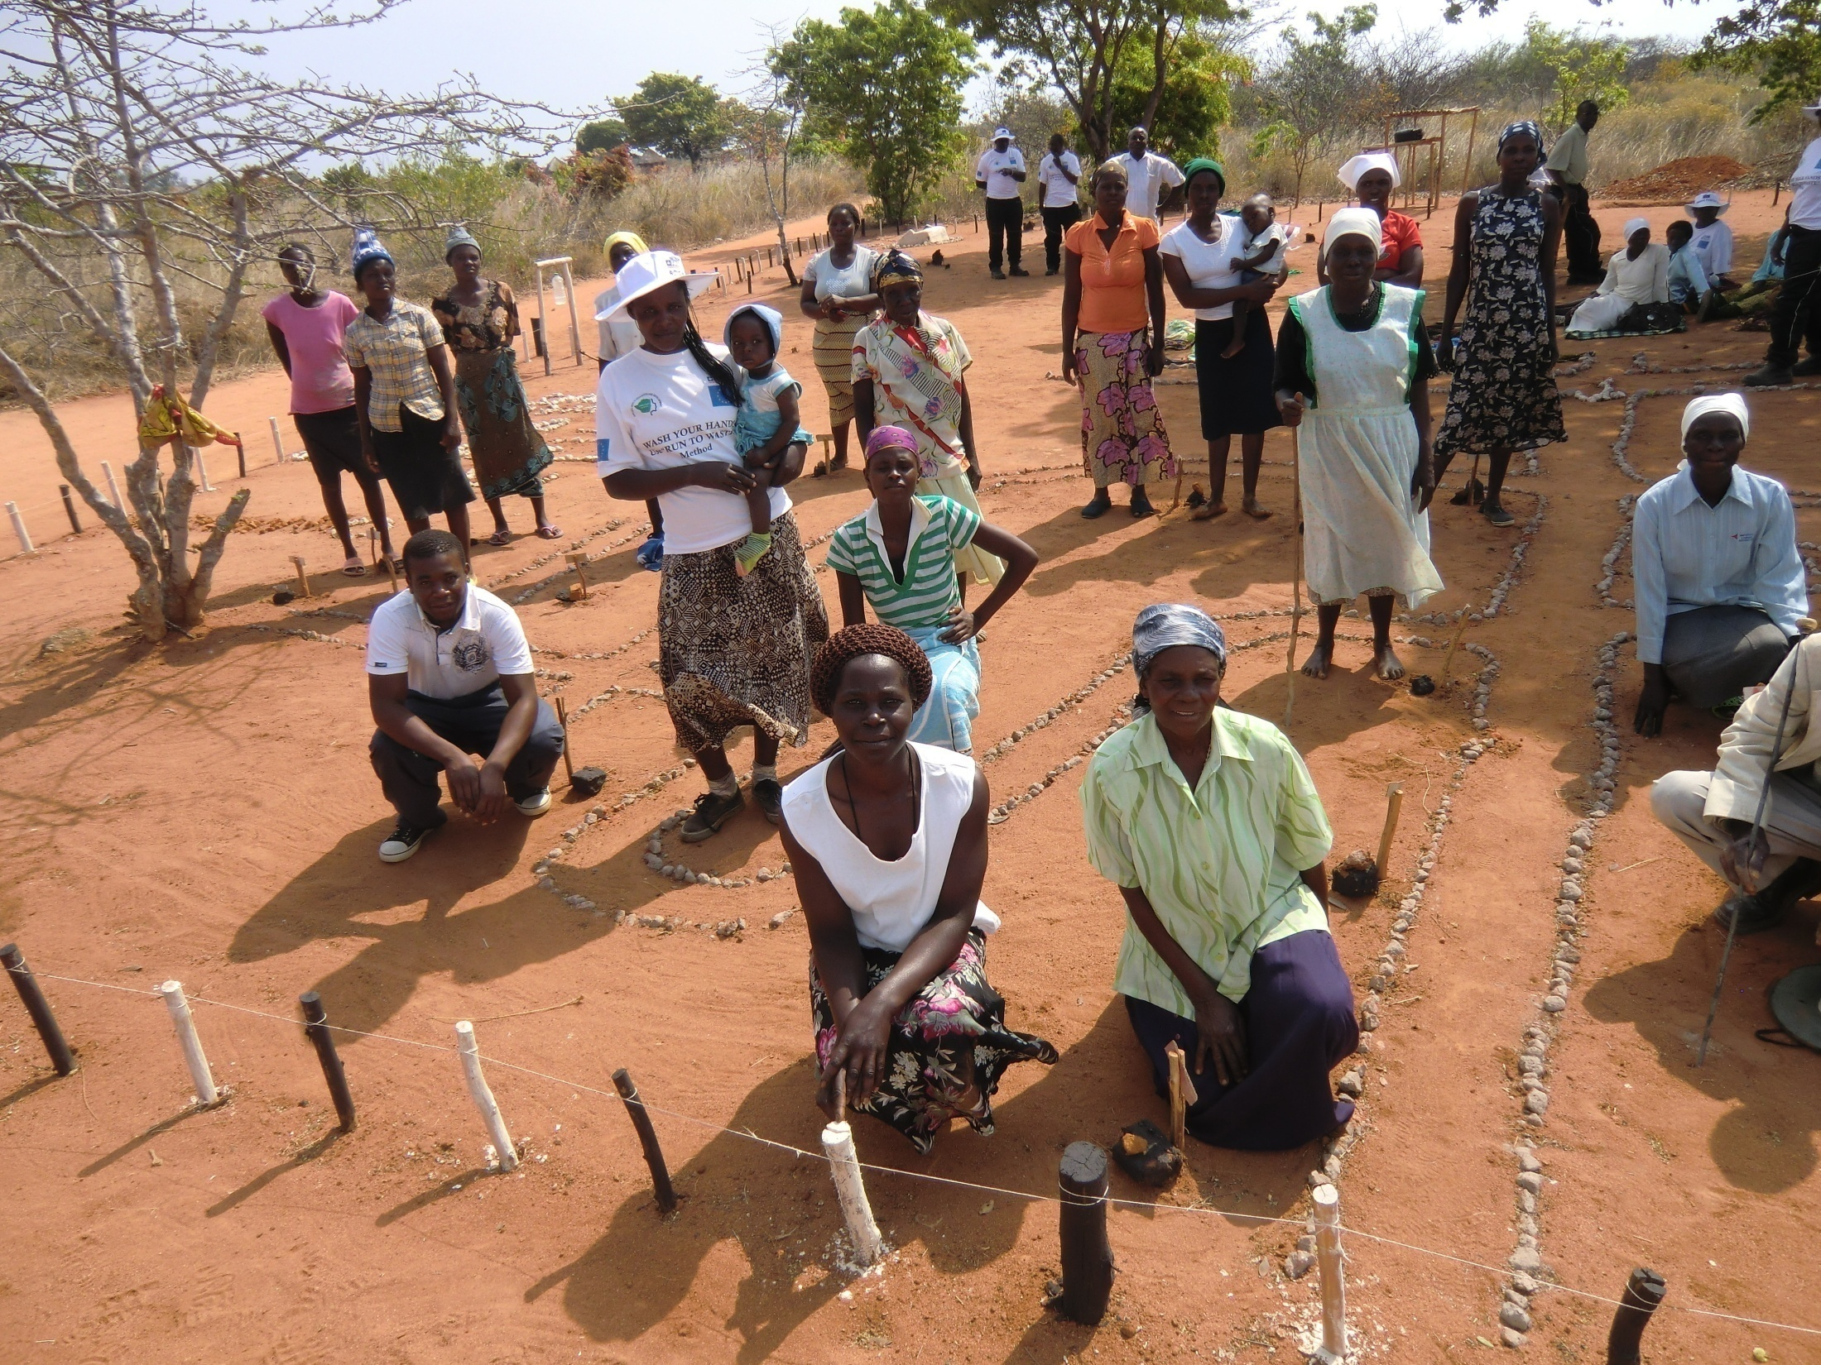
CHC and CLTS:
How can they be integrated?
Dr. Juliet Waterkeyn,
UNC Conference:
CHC seminar.
Nov. 2012
Notes:
Positive Peer Pressure
There is, in addition, another key component of the CHC Model that ensures a high degree of participation - the well-known phenomenon of ‘peer pressure’. The health club is made up of members who start to reinforce each other in order to bring the group as a whole up to the same level. Once a critical mass of members have started to make a certain change, it becomes the fashion, and, like all fashions the remaining members will often change just to be the same as everyone else. In this way the CHC approach helps to bond communities and has been sucessful rebuild post conflict societies, notably in Sierra Leone and Uganda..
Thus the positive peer pressure which encourages and assists the vulnerable and poorest of the poor to conform to the norm, is the exact reverse strategy of CLTS which uses negative peer pressure to shame and embarrass people into good behaviour. Development practitioners should be seeking to encourage more peaceful development in communties, particularly those which have already been torn apart by civil war and political intimidation in societies across Africa. Using the CHC approach communities can achieve the same levels of sanitation and hygiene behaviour change as CLTS, and with more sustainability. The ‘sense of belonging’ that develops in CHCs, is a need that few development programs have identified and which few strategies can be bothered to foster. Community Health Clubs are a vehicle for consensus and group action based on shared norms and behavior.

Slide 2
A Model of Development is one that can be used to explain:
1. Why people are galvanised into action.
2. Predict the conditions under which such action will occur.
3. It should also demonstrate the relationship between knowledge, belief, social norms and behaviour.
Notes:
One of the main criteria for a rigorous study is that it should be based on a Theory (Loevinhson, 1990) A theory is a model of development that can be used to explain why people are galvanised into action and predict the conditions under which such activity occurs. It should also demonstrate the relationship between knowledge, belief, social norms and behaviour (Nutbeam, 1999.a).

Slide 3
A Model is the visualisation of a Theory which is based on Assumptions formed by:
Direct experience and observation
Indirect sources: read or been told by people or trusted sources(Head man).
For example:
To get people to change they need to be shamed into good behaviour.
People change behaviour because they want to improve their children’s chances of survival.
Notes:
The proposition or hypothesis is based on my understanding of the situation, and this understanding is based on: 1. On my own experience and observation, and 2. On what I have read or been told by people or sources that I can trust i.e. people that don’t lie, and academics whose papers have been peer reviewed or pass certain test of rigour, eg p>0.001 is a statistical sign that the research is near to the actual truth.

Slide 4
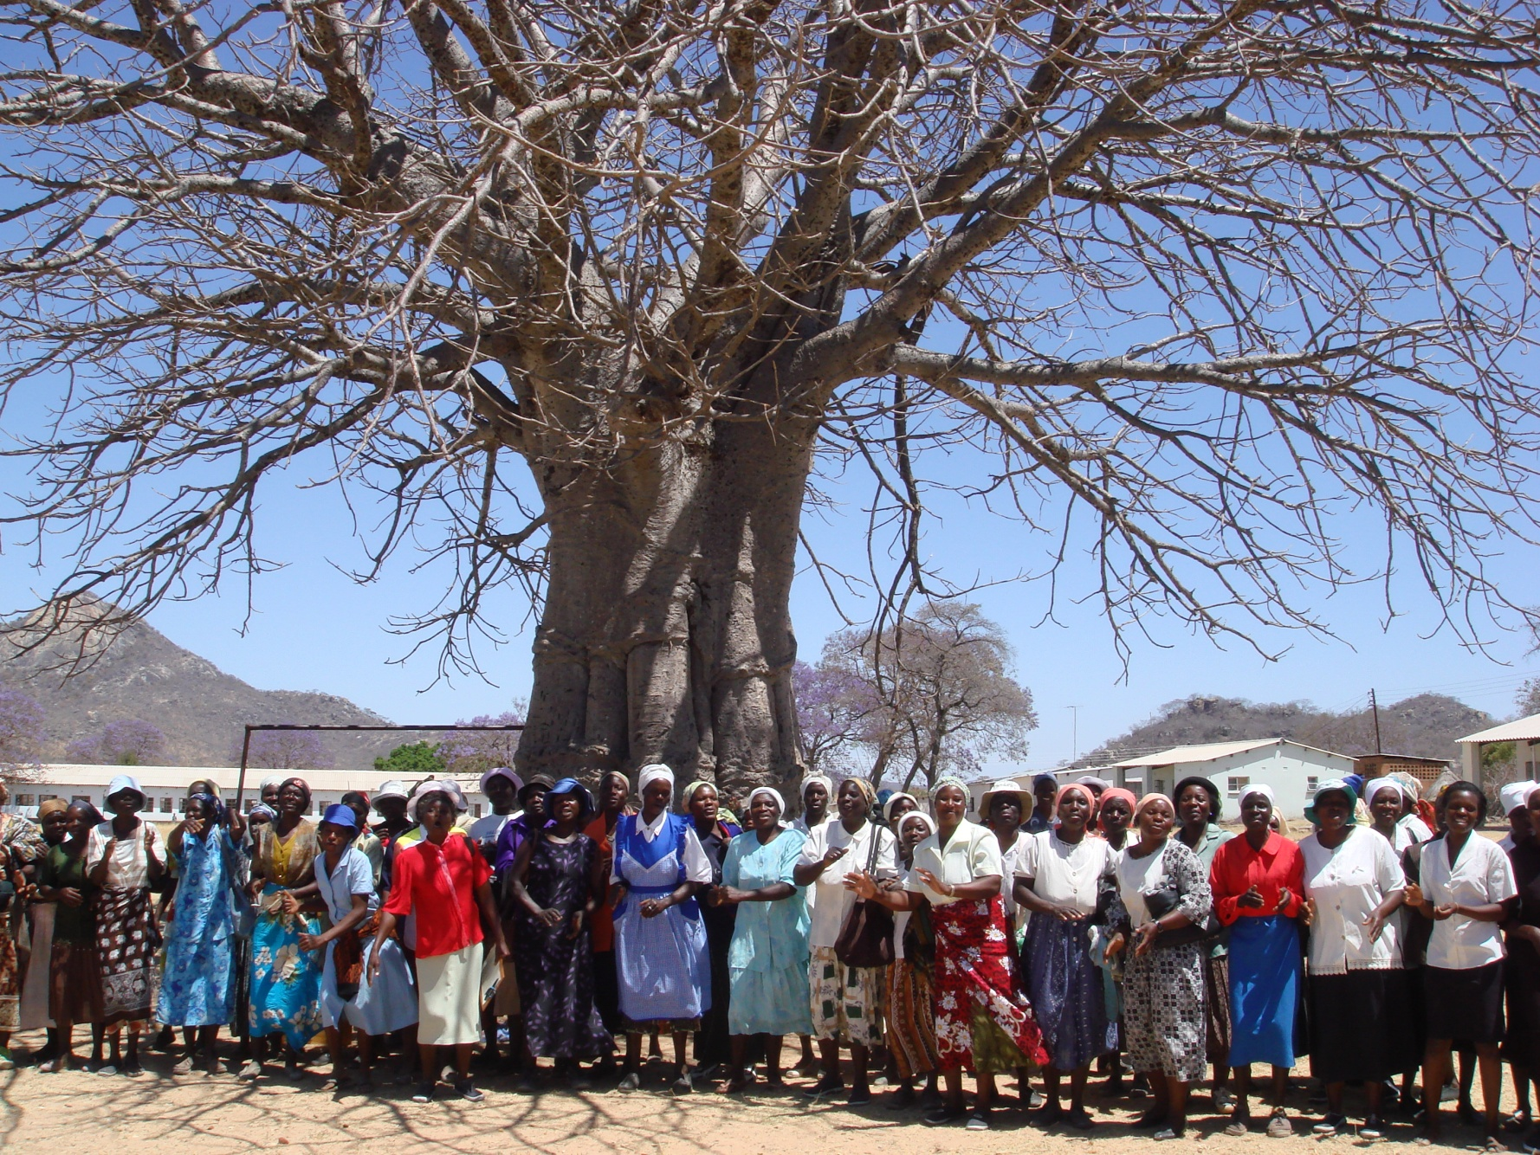
Both target the community as a ‘Group’
Notes:
Group consensus
Unlike CLTS, the CHC approach builds on traditional African values of group consensus. Julius Nyerere, first President of Tanzania, once said that whilst in western democracies the balance of power is kept by a political system of two or more parties that keep each other in check by mutual criticism, ‘In Africa, we sit under a tree, until we agree.’ Whilst at National level, modern dictatorships in Africa bear little witness to this harmonious approach, at village level, contentious issues still tend to be thrashed out by dialogue through the headmen and elders, using customary laws to guide judgements, until all parties agree in the interest of the community as a whole. This is similar to what takes place at the weekly health sessions between members of a Community Health Club. It provides a forum for debate on public health issues guided by a facilitator with a toolkit of visual aids which help members understand their own health issues and manage all preventable diseases - not just diarrhoea, but malaria, malnutrition, bilharzia, worms and skin disease. Once mother’s realise that they themselves can control disease through good hygiene and sanitation, the uptake is strong as they are naturally highly motivated to ensure the childrens survival.
In subsistence communities throughout Africa there are positive values that can reinforce ‘good development practice’. The wisdom of age is still respected at village level, no matter the level of education of the elderly. In Southern Africa the ideal of Ubuntu, the strength and importance of ‘togetherness’, rather than the rights of an individual, is an ideal long forgotten in urban societies.

Slide 5
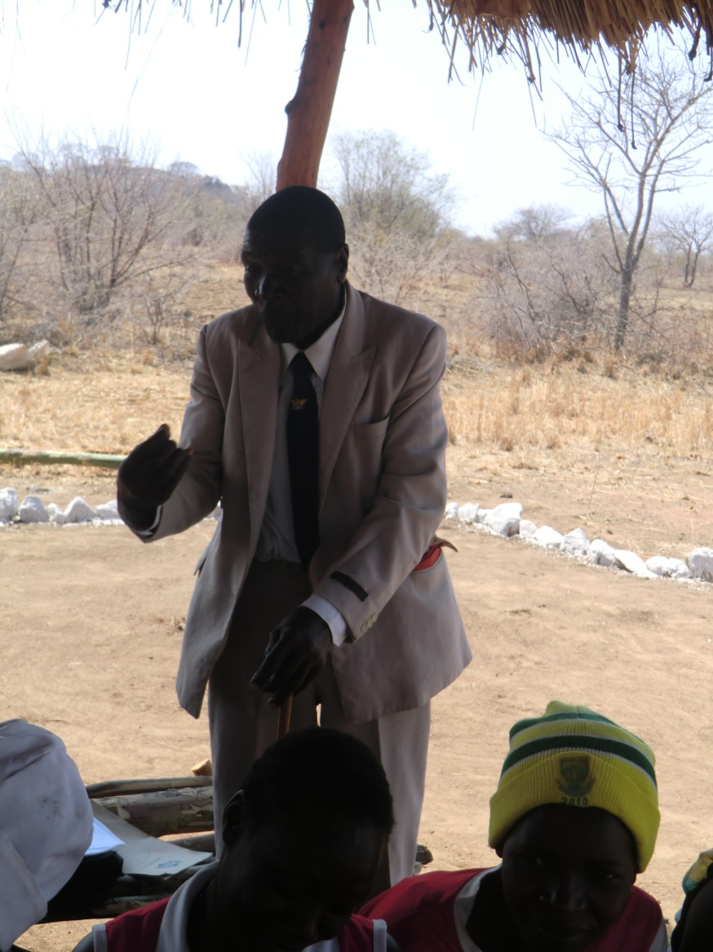
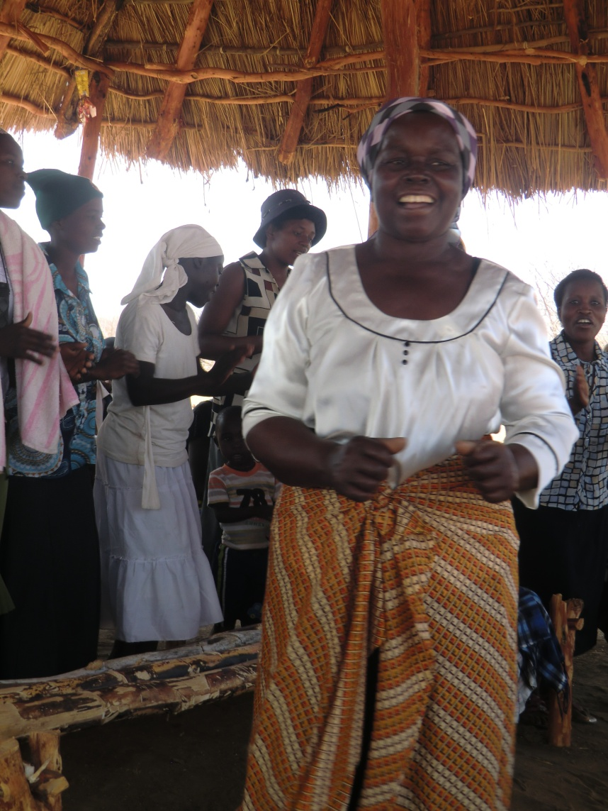
Both Community Led Approaches
CLTS through village Traditional Leaders
CHC through village women
CHC Chairwoman
Notes:
Two strategies have emerged in the past decade, which target with the group as a whole rather than the individual: Community Led Total Sanitation (CLTS) and the Community Health Club (CHC) approach. CLTS works through the existing leadership of a villages giving responsibility to the traditional leaders to conduct the initiative. The Community Health Club entails the creation of a new structure in which each household is represented by a member who attends weekly meetings. This enables women themselves to be empowered to manage their own health, and is a truly community led initiative. A health club is not floating free from existing structures but is introduced by the existing village leadership, who are often on the executive committee of the club. The Chairperson is a local woman but not necessarily the Village Health Worker who is the facilitator of the sessions. Both CLTS aim to involve the whole village, but CLTS is ‘top-down’ from village leaders to villagers, whereas CHC is ‘bottom-up’ from villagers to their leaders.
This type of social censure is a degree more inhumane than the colonial practice of hygiene inspectors who inflicted fines which hurt the pocket but not the reputation. It should be analysed whether the Public Health sector has not done a full circle and returned to the illiberal activities of the 60’s, whilst cleverly empowering communities to do their own dirty work. Surely to prevent this abuse hygiene campaigns/programmes should have to comply to an ethical standard (much like a research protocol) before being foisted on communities who are unable to protect themselves.
The best aspect of CLTS is its name: Community Led Total Sanitation is an ingenious slogan. In the past two years CLTS has been started in over 30 African countries in a desperate bid to meet the MDG targets for halving the number within each country without sanitation, and this is being pushed hard by Unicef, as well many international NGO’s. There appear to be many success stories of ‘total sanitation’ where all members of the community are said to construct latrines without any subsidy to build latrine. Who would challenge such a good deal for development, particularly when donors and governments alike can no longer subsidise mass sanitation. There is a new Scramble for Africa, as only 5 countries in the continent are likely to meet the Millennium Development Goal of halving the number without sanitation by 2015? However, it must be asked, ‘Does the means justify the end’? Is the draconian strategy used by CLTS to achieve latrine construction the only, or even the best, way of achieving the MDGs?

Slide 6
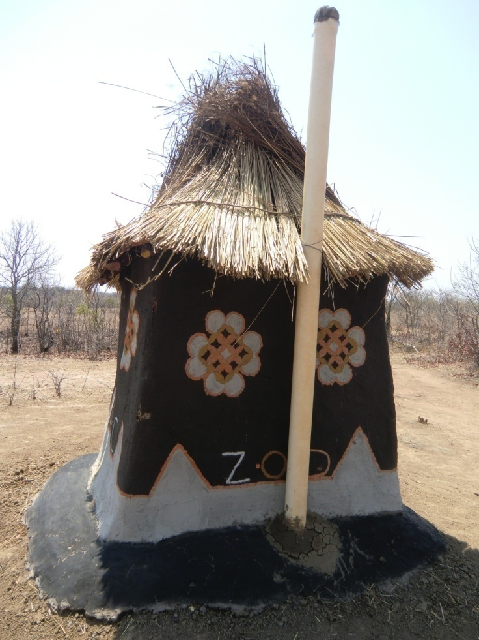
SANITATION CONSCIOUSNESS & NO SUBSIDY
Open Defecation Free area = Zero Open Defecation (ZOD)
No subsidy: develop Self reliance and Dignity: No need for charity handouts

Slide 7
Basic Assumption of Classic CLTS:
Negative peer pressure
People will change if they are shamed into good behaviour
i.e. ‘Naming and Shaming’
Conservative and Authoritarian
The training manual for CLTS (Kar) advises
the ‘key is standing in the OD area, inhaling the unpleasant smell and taking in the unpleasant sights of shit lying all over the place. If people try to move you on, insist on staying there despite their embarrassment. Experiencing the disgusting sight and smell in this new collective way, accompanied by a visitor to the community is the key trigger for mobilisation.’
Notes:
At the Triggering event, a favourite trick is to take a hair, wipe it in a load of shit, then dangle it in a glass of water and offer it to the assembled villagers to drink. Alternatively, a plate of rice is placed next to a pile of fresh shit and the community are offered some fly walked food, which they naturally refuse. This is a very clear demonstration which invariably makes the point that they are eating and drinking each others shit. The objective of the ‘walk of shame’ is the moment of ‘ignition’- the ‘aha’ moment when the assembled villagers feel embarrassed enough about their open defecation to agree to do something about the situation. There is no attempt to be polite or conform to local standards of acceptable social manners, and this purposeful insensitivity often offends communities, and goes against the instinct of most social scientists.

Slide 8
The handbook for CLTS cites unabashedly a successful case study:
‘In the districts of NW Bangladesh, children were known as ‘bichu bahini’ – the army of scorpions. They were given whistles and went out looking for people doing OD. One youth said that during the campaign for ODF he had blown his whistle at least 60 times. In a few cases they carried out ‘goo jhanda’, flagging piles of shit with the name of the person responsible.’
Notes:
In some places children have been used to lead the visitors to the shitting field. In effect, these children have been empowered, not with knowledge, but with social control over their elder’s most private moments. Surely in any culture this is unacceptable?
CLTS is apparantly an ingenious method which ‘kindles feeling of shame and disgust’ shocking the ‘community’ into taking action and making sure that the whole village is Open Defecation Free (ODF). As it challenges the taboo of community by looking at people’s shit and exposing them for behaving badly, the process requires an experienced facilitator who is able to ‘trigger’ the community by manipulating these sensitivities.

Slide 9
1. METHOD : two Classic Models
CLASSIC CHC Approach:
CLASSIC CLTS Approach
One ‘Triggering’ day +
a few follow-up visits
• 6 months Hygiene sessions
20 sessions (each week)
Village walk to shock community that they are eating their own faeces
• Learning through participatory activities reinforce good practice
• weekly meetings require homework : voluntary household improvements
• Community shamed into building latrines and no open defecation
• Members are rewarded with social acknowledgement
Leaders enforce compliance with fines or social censure

Slide 10
Faecal-Oral Transmission Route
Most cost effective as it targets all
routes of diarrhoea transmission as well
Fluids
Community Health Club Approach
Faeces
Fields
Food
Mouth
Community Led Total sanitation
Flies
as all preventable diseases: malaria, bilharzia, worms, skin disease, ARI, trachoma, HIV/AIDS
Social
Marketing
Fingers
2. SCOPE
Source: The F Diagramme: PHAST Step-by-step Guide 1998
Notes:
Diarrhoea and other diarrhoeal disease (such as cholera) are most often targeted in water and sanitation programmes as they can be prevented purely by good hygiene. However, diarrhoea has multiple transmission routes, and therefore is not controlled by changing just one high risk practice. Diarrhoea is transmitted if hands contaminated by faeces touch food which is then ingested: handwashing with soap blocks this transmission. Alternatively flies can contaminate food with faecally contaminated feet and this route can be blocked is by safe sanitation: either by having a completely hygiene sealed latrine, so that flies can have no access to the faeces or by burial of faeces in a covered hole in the ground (cat sanitation). The Ventilated Improved Pit (VIP) latrine was developed to lure flies down a pit to breed and trap them as they try to fly out through the vent-pipe which has a gauze to prevent their escape. One of the biggest challenges in developing countries is ‘open defecation’ not because it is unsightly and undignified but because there fly control is impossible. Therefore cat sanitation is the first stage of safe sanitation behaviour. Other main transmission routes are through dirty food or faecal contaminated water that induces diarrhoea and vomiting. Therefore diarrhoea has to be combated, not only by sanitation, but more particularly by general hygiene, which can effectively prevent all transmission routes. Whilst many programmes aim to provide technology that ensures safe drinking water, this safe water is often contaminated in the home by the way it is used - by a dirty hand in a water container whilst drawing water. Equally when food is eaten by hand, those with dirty hands, (or those who share the same place with people who have dirty hands) will be exposed to contamination by e coli. Hygiene promotion that results in self supply of safe sanitation and protection of drinking water in the home, as well as a safe environment with correct disposal of feaces should therefore able to reduce diarrhoea completely.

Slide 11
Observed Indicators of Sanitation and Hygiene between
CLTS and CHC villages in Zimbabwe
2011.Whaley & Webster
Notes:
COMPARATIVE RESULTS: CLTS AND CHC METHODOLOGIES
Recent research by Whaley & Webster (2010) provides one of the few behaviour change studies that has actually compared the two methodologies, Community Led Total Sanitation and the Community Health Club Approach. The study provides unique insight into the effectiveness and sustainability of the two methodologies in terms of achieving sanitation and handwashing in the same areas of rural Zimbabwe. ‘Effectiveness’ was understood as ‘the extent to which acceptable sanitation and hand washing measures had been implemented. ‘Sustainability’ was taken to mean the continued existence, use, cleanliness and maintenance of sanitation and hand washing facilities over time, in this case two years since the training had taken place.’ A total of 233 households were surveyed in ten communities, 128 in Chiredzi district to measure the effectiveness of the approaches six months after inception. The remaining 105 were from Chipinge and Mutoko districts and related to the sustainability of the approaches two years after their inception.
Effectiveness
In Chiredzi district, six months after the end of the project, 92% of the CHC respondents were found to be practicing ODF (26% having building their own latrines since the project started, and 66% using cat sanitation) as opposed to 77% of the CLTS sample (of which 44% had a latrine but all of them built prior to the project) whilst the remaining 57% claimed to share a latrine). In the CHC areas there was a 64% uptake of handwashing with soap, whereas there was virtually no uptake of handwashing in the CLTS areas, with only 10% owning and using a handwashing facility (p>0.0001).

Slide 12
Comparing Health Promotion Strategies
Type Focus Disease # Messages % Change Country
1.PHAST Narrow Diarrhoea 17 5.6 % Uganda
2. Social Marketing Narrow Diarrhoea 4 13 % Burkina Faso
3. CLTS Narrow Diarrhoea 1 33% triggered Nigeria
4.CHC Approach Holistic Diarrhoea 17 47% Zimbabwe
Skin disease
Eye Disease
Worms
ARIs
HIV/AIDS
Malaria / Bilharzia
Palmer (WSP-World Bank) (2005) 2.Cave & Curtis, 2002. 3. WaterAid , 2010.
4. Waterkeyn & Cairncross, 2005

Slide 13
Behaviour Change
Behave Yourself
Self directed
Imposed from outside
Sticking plaster
Knowledge
Beliefs
Values
Behaviour
Changed Values
SUSTAINABLE:
A CULTURE OF HEALTH (REAL CHANGE)
Changed Behaviour
SUPERFICIAL CHANGE
UNSUSTAINABLE
(SHORT TERM)

Slide 14
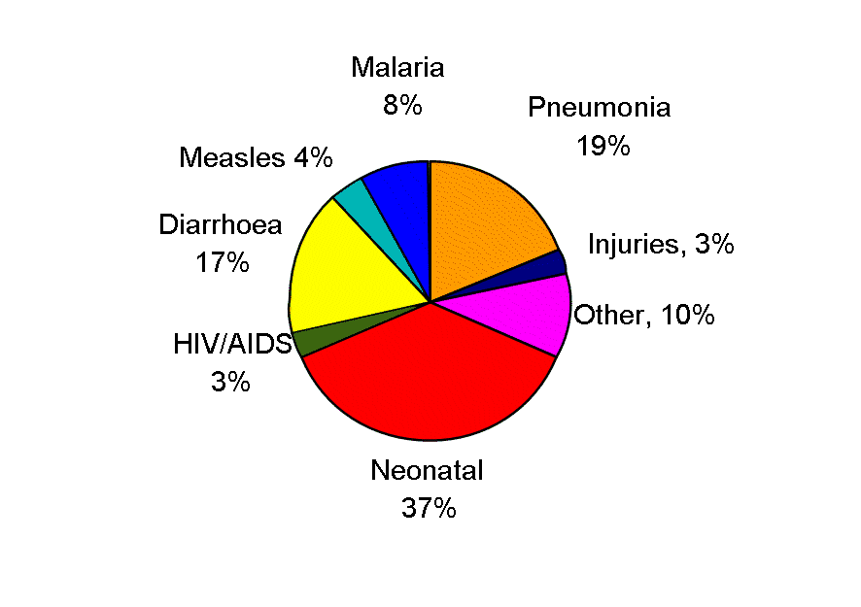
THE HEALTH CHALLENGE :
11 million children die each year
2. SCOPE
88% can be prevented by good hygiene

Slide 15
Where CLTS and CHC differ
Classic CLTS is a NARROW focus on achieving sanitation
CHC is a BROAD focus of all preventative diseases – sanitation is but one indicator out of at least 20 indicators of good hygiene in the home:
Notes:
Behaviour Change
In programmes run by Zimbabwe AHEAD Organisation, the NGO that pioneered the Community Health Club Aproach in 1999, there has been little resistence by the community to forming clubs and attending sessions. Health clubs continue to attract vast numbers of people and a club can vary from the smallest of 30 members up to as many as 100 or 150, when they are usually split into two clubs. A recent programme where 480 CHCs were started in Masvingo and Mbergenwa districts, every single household in the project area had one person in a CHC, and 38% of households had more than one member in a club. Latrine coveage rose within 6 months from 22% to 70%, with the expection of Zero Open Defecation (ZOD) within the year. Even after six months of attending one session every week the members frequently want to continue meeting weekly and many go on to start income generating projects or develop nutirition gardens. This sharing of knowledge and understanding leads to a common belief and vision and in turn to action that is approved by the group. Each session has a recommended practice that the whole membership agree to endorse, starting with simple practices like covering water, and ending with construction of latrines and handwashing facilities. Instead of each person having to make an individual decision, a group decision is made and everyone tries to comply to the accepted standard.

Slide 16
Presentation by SNV for Banglasdesh Rokeya, 2009.
Revitalised /evolved CLTS A working definition of 100% sanitation
No open defecation or open/hanging latrine use.
Effective hand-washing after defecation and before eating / taking or handling food.
Food and water are covered.
Good personal hygienic practices, such as brushing teeth and trimming nails
Latrines are well managed.
Sandals are worn when defecating.
Clean courtyards and roadsides.
Garbage is disposed of in a fixed place, such as a pit.
Safe water use for all domestic purposes.
Water points are well managed.
Waste water is disposed of down drains or in a fixed place.
Notes:
The answer is ‘No’. Many NGOs are aware of the issues raised above and are seeking to ‘revitalise’ or ‘evolve’ CLTS into a more benign strategy, whilst at the same time hanging onto the funding that comes with CLTS. The drift from one sessions is towards many more sessions to reinforce CLTS and expand it to include handwashing and other hygiene interventions. This effectively changes CLTS in the direction of the CHC Approach, which is already doing precisely this, achieve behaviour change just as effectively as CLTS and without upsetting the norms and taboos of the ’beneficiaries’, whilst addresses a wide range of hygiene practices. The CHC activities include a more culturally sensitive variation of the village transect walk by drawing a map of the village on the ground with people indicating if they have latrine, either temporary or permanent. This variant of CLTS is routinely done as part of a series of 20-24 hygiene sessions over a six month period in the Community Health Clubs.

Slide 17
Objectives of the Programme : blanket coverage of all households with ZOD
Higher CHC targets than ever before :
Community Led: Every house hold having a CHC member
Total Sanitation: all households having safe sanitation
Zero Open Defecation (ZOD) was adopted as the slogan.
It means the same as ODF except it is easier to sing
ZOD means:
Open defecation free (no faeces on the ground)
Latrine should not allow fecal transmission by flies
to be properly covered toilet (Flies cannot enter)
VIP with functional ventpipe (gauze to trap flies exit)

Slide 18
3. LENGTH

Slide 19
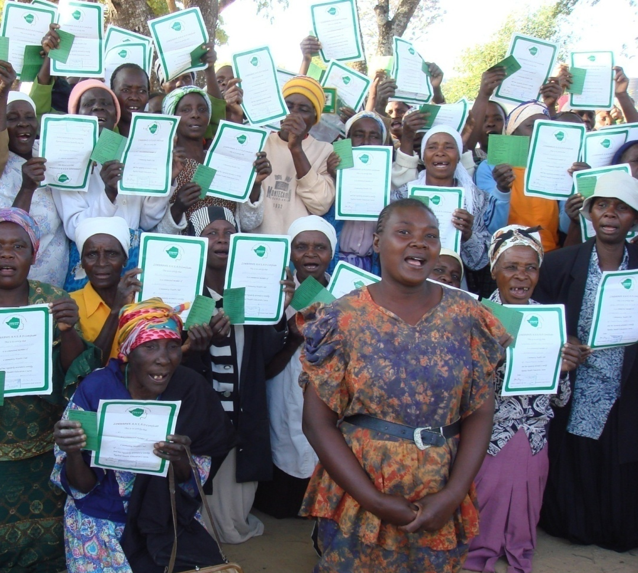
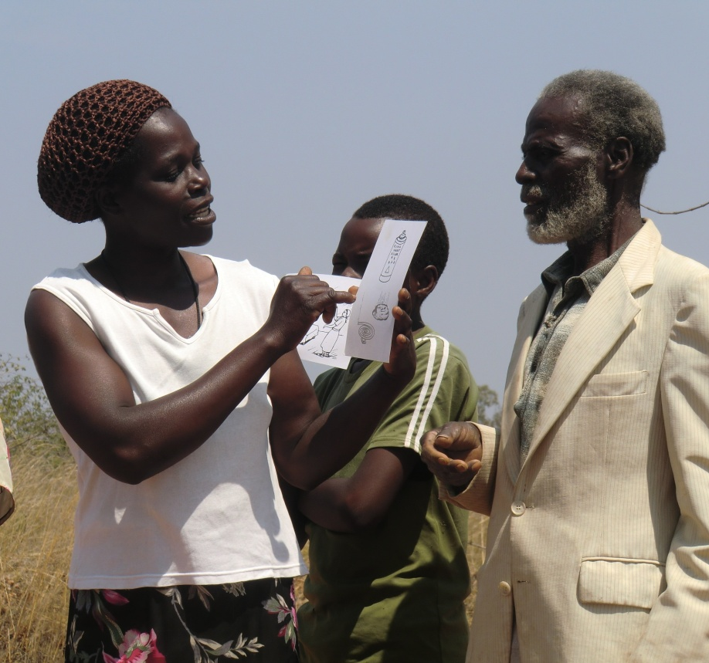
Basic Assumptions of CHC :
Positive peer pressure: Need to Achieve and Improve
BC reinforced by community recognition and reward
i.e. liberal and progressive

Slide 20
THE BIG DIFFERENCE: OUR BASIC ASSUMPTIONS
ETHICAL BEHAVIOUR CHANGE SHOULD:
Enhance not undermine community
Use positive not negative peer pressure
Build consensus rather than divide
Appeal to group rather than individual
Notes:
5. Why do I think this? Literature and those more experienced have analysed peasant cultures and many anthropologists have noted how most traditional societies where community is paramount, and people are homogeneous, want to be like each other. There is a the love of ‘rapport’ (togetherness) in traditional cultures those who in these conservative societies who try to be different challenge the social norms of the group are often outcast or ostracised. This is the PhD (Pull him Down) syndrome at work: a levelling mechanism that ensures the groups stays within its culture, and enables cultures to survive and be based on, much the way genes are passed on by human bodies.

Slide 21
: Recommendations
The BOTH survey results were similar to those of the CHC survey (see Appendix Tables B7 and B8 for results, available online at http://www.iwaponline.
com/washdev/001/015.pdf) with the exception of ‘the presence of a latrine’ which differed significantly (26% CHC versus 93% ‘BOTH’, p,0.0001). This suggests there is
scope for the two approaches to complement one another
Revitalise / Evolve CLTS
CHCs should be started in areas where there is already or where there will be CLTS
CLTS Triggering is one of the 20 sessions in the CHC curriculum

Slide 22
THE END

Slide 23
CLTS In Nigeria : extact from ‘Revitalising CLTS: A Process guide, Wateraid . 2011
‘Unsatisfactory results: Reports from a monitoring exercise conducted by NTGS indicated a large number of unsatisfactory results and outputs from implementing the approach in Nigeria. Over 1500 communities were reported to have been triggered but less than 500 to be open defecation Free –the first step towards total sanitation. …. The main reason suggested as poor facilitation….
Regional training on CLTS by Unicef and WaterAid provided by Kamal Kar and Richard Chambers failed to result in significant progress in communities reaching ODF, leading to a demand for deeper analysis to increase the effectiveness and impact of CLTS in Nigeria. The most recent evaluation (2009) was very specific on the dangers of promoting CLTS as it is currently done
Notes:
Although it is claimed many villages respond to the triggering with 100% (!) Open Defecation Free (ODF) area, some villages don’t respond to this approach and do not try to clean up. They are termed ‘damp matchboxes’ because they don’t ignite, and are simply ignored until they see the error of their ways. In Nigeria one third (500 of 1500) of the villages that were assessed by WaterAid were ‘damp match boxes, not a successful outcome by any standard. Furthermore of the 1000 villages that did claim ODF status, many had regressed to an estimated 60% ODF within six months. More research is needed to ascertain why some villages don’t respond, as it is clear from a sociological perspective that CLTS is bound to run into many cultural blockages, due to its disregard of cultural norms. Research in four West African countries (WaterAid 2009) notes ‘that there is insufficient consideration of socio-cultural barriers in the CLTS method’.
One of the key challenges identified in the CLTS process in Nigeria was the quality of facilitation and that ‘for effective communication the communities must be treated with respect in order for them to take an interest and responsibility for their sanitation practices’.
Respect is not a word that is associated with this approach which does its best to shock the community ignoring cultural sensitivies. Facilitators who are extrovert enough to able to navigate this counter cultural activity without embarrassment are apparantly in short supply.

Slide 24
At its mildest, this (CLTS) meant squads of teachers and youths, who patrolled the fields and blew whistles when they spotted people defecating. Schoolchildren whose families did not have toilets were humiliated in the classroom. Men followed women – and vice versa – all day, denying people the opportunity even to urinate. These strategies are the norm, not the exception, and have also been deployed in Nepal and Bangladesh.
10. ETHICS
Notes:
CLTS is a one-off event and after the initial shock treatment, the ‘community’ are left to work things out for themselves (ie community led) but whilst this sounds enlightened this lack of monitoring has sometimes resulted in abuses of power by local leaders who are coercing villagers to tow the line as Village leaders are anxious to gain the prizes or reputation of being ODF. As a result individuals who do not comply have been publically tormented. There are also many reports of zealous leaders who encourage children to report on their elders and those offenders are publicly humiliated. The approach, which openly encourages the use of shame and embarrassment as a trigger, is one which also provides an opportunity for local elites to use dehumanising methods. Stories are filtering out through the media and on the internet.

Slide 25
Equally common, though, were more questionable tactics. Squads threw stones at people defecating. Women were photographed and their pictures displayed publicly. The local government institution, the gram panchayat, threatened to cut off households’ water and electricity supplies until their owners had signed contracts promising to build latrines. A handful of very poor people reported that a toilet had been hastily constructed in their yards without their consent.
10. ETHICS

Slide 26
A local official proudly testified to the extremes of the coercion. He had personally locked up houses when people were out defecating, forcing them to come to his office and sign a contract to build a toilet before he would give them the keys. Another time, he had collected a woman’s faeces and dumped them on her kitchen table. (Chaterjee, 2011).
10. ETHICS

