Slide 1
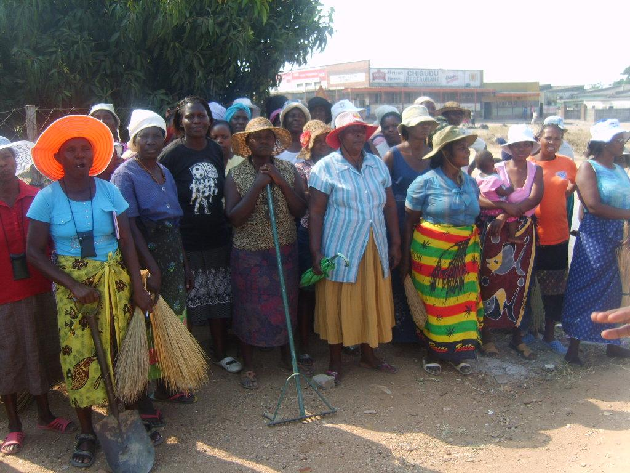
Urban Community Health Clubs in 6 Town of Zimbabwe Presented by Africa AHEAD:
Juliet Waterkeyn & Regis Matimati Water and Health Conference, UNC 2015

Slide 2
Sustainable Development Goal CHALLENGE: Goal 11: Sustainable cities and communities
To enable ‘farmers who come to town” to cope in an urban context, empowering them with life skills for survival and improving living standards.
Notes:
Make cities inclusive, safe, resilient and sustainable
More than half of the world’s population now live in urban areas.
By 2050, that figure will have risen to 6.5 billion people – two-thirds of humanity. Sustainable development cannot be achieved without significantly transforming the way we build and manage our urban spaces.
The rapid growth of cities in the developing world, coupled with increasing rural to urban migration, has led to a boom in mega-cities. In 1990, there were ten mega-cities with 10 million inhabitants or more. In 2014, there are 28 mega-cities, home to a total 453 million people.
Extreme poverty is often concentrated in urban spaces, and national and city governments struggle to accommodate the rising population in these areas. Making cities safe and sustainable means ensuring access to safe and affordable housing, and upgrading slum settlements. It also involves investment in public transport, creating green public spaces, and improving urban planning and management in a way that is both participatory and inclusive.

Slide 3
Goal 11: Creating Communities in Cities through Community Health Clubs
In Zimbabwe CHCs have been formed in high density areas in 6 towns.
CHCs have enabled more interface between local government and residents, with clean ups and cooperation in drainage and waste disposal.

Slide 4
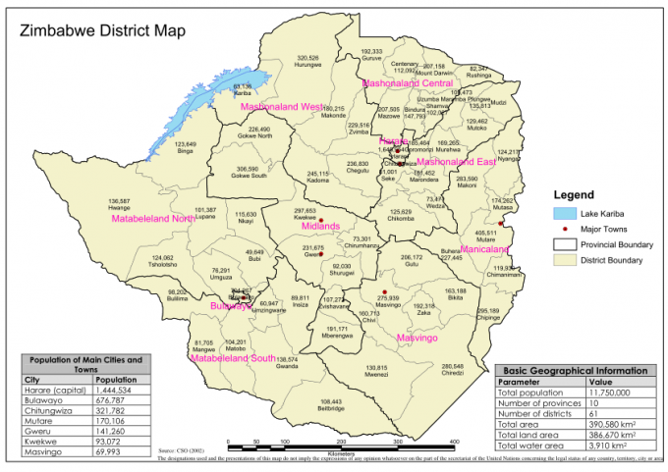
331 CHCs
27,692 members
Cost of CHC Project
US$2.87 per person
Bindura
Harare (capital)
(1,444,534)
Mutare (170,106)
Masvingo
Chipinge
Mavingo (pop.69,993)
Chiredzi

Slide 5
Africa AHEAD Urban Community Health Clubs in Zimbabwe 2008-15
 | 2008 | 2009 | 2010 | 2013 | 2014 | 2015
Towns/cities | Mutare | Chiredzi | Masvingo | Chipinge | Bindura | Harare | TOTAL
Number of CHCs | 36 | 180 | 9 | 41 | 17 | 48 | 331
Number of Members: | 5,400 | 17,045 | 1,165 | 2,144 | 1,038 | 900 | 27,692
School Health Clubs |  |  | 10 | 10 | 10 |  | 30
Number of SHC members |  |  | 930 |  | 5294 |  | 6,224
CHC Facilitators: | 10 | 30 | 9 | 41 |  | 18 | 131
Number of beneficiaries: | 23,600 | 102,270 | 6,990 | 25,676 | 44,033 | 7,200 | 209,769
Cost of Project: US$ |  | 111,312 | 27,500 | 134,000 | 117,000 | 3,400 | 393,212
US$ Cost beneficiary: |  | 1.0 | 3.93 | 5.2 | 2.65 | 0. 47 | 2.65
Partner | OXFAM | OXFAM | OXFAM | ACF | GAA | MSF
Donor | OFDA | OFDA | OCHA | Unicef | Unicef | Belg

Slide 6
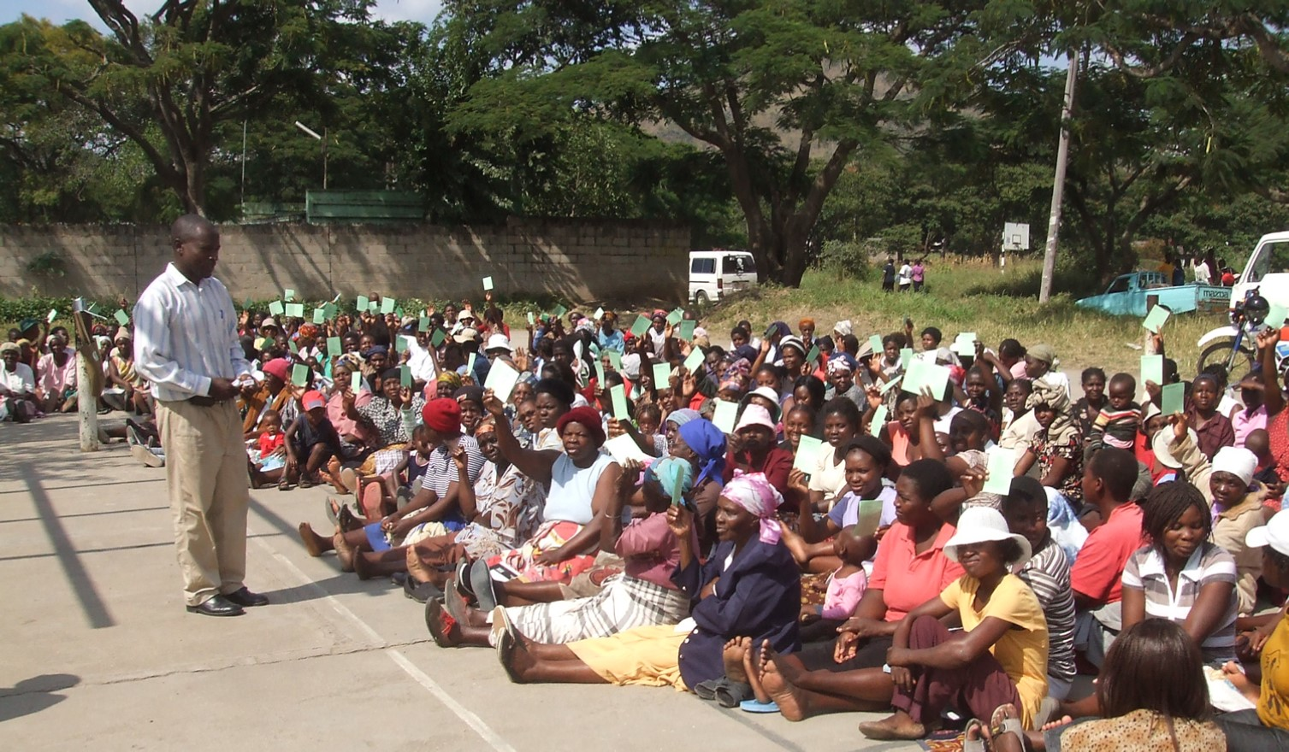
1.
Cholera Mitigation in Mutare Town: 4 cases & no deaths
In Manicaland, a Province with a population of 1.6 million, there were 12,704 cases with 420 deaths. In Mutare Town (pop.195,300) ‘only’ 198 reported cholera cases and 8 deaths from December to April 2009.
Notes:
By March 2009, a total of 89,018 Zimbabweans out of 11 million had contracted cholera and 4,011 had already died.

Slide 7
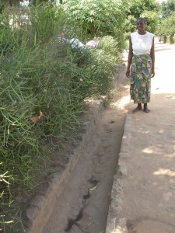
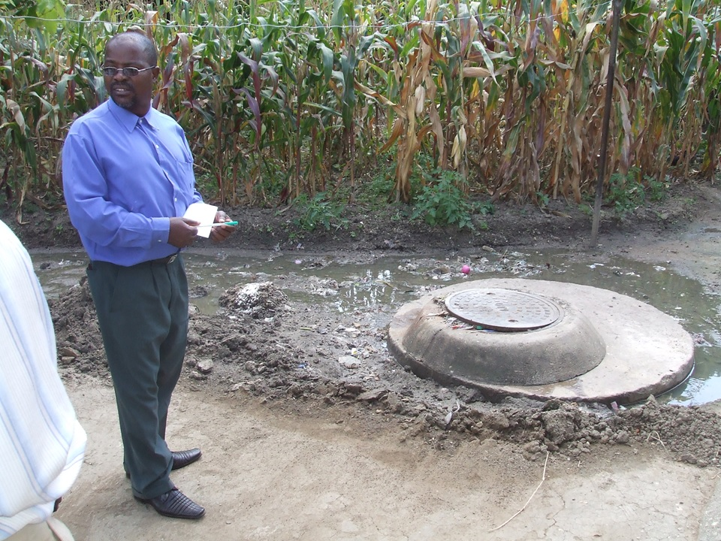
Community working with Council
Each household undertook to keep their own drains cleaned to ensure run off in the rains.
Incredulous City Council
The City Council estimated that the clean up done by the CHC members would have cost US$ 20,000 if they had used their dump trucks and six months of manpower but they had no dump trucks!
The Council now give contracts for solid waste disposal to the health clubs.

Slide 8
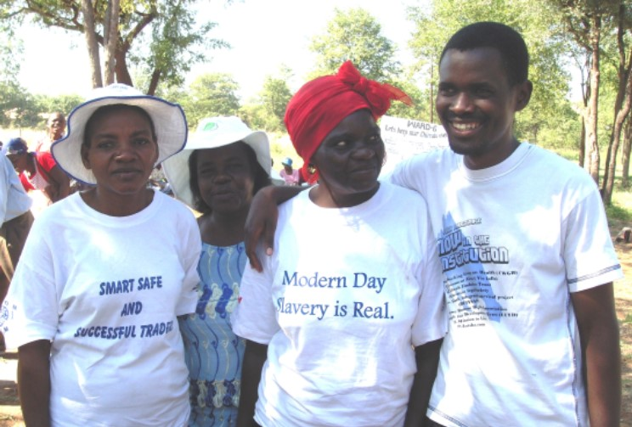
2.
Chiredzi Town: Reducing crime through CHCs
‘Since the introduction of the Clubs there has been a sharp decline in abuse cases in the area. I attribute this to the increased vigilance of the community following the sessions, and also to the fact that perpetrators now know abuse is unacceptable and will be reported to the relevant authorities.’
Officer-in-Charge of Chiredzi Police

Slide 9
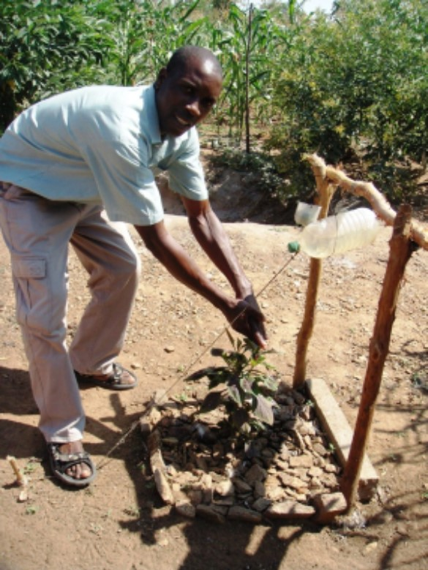
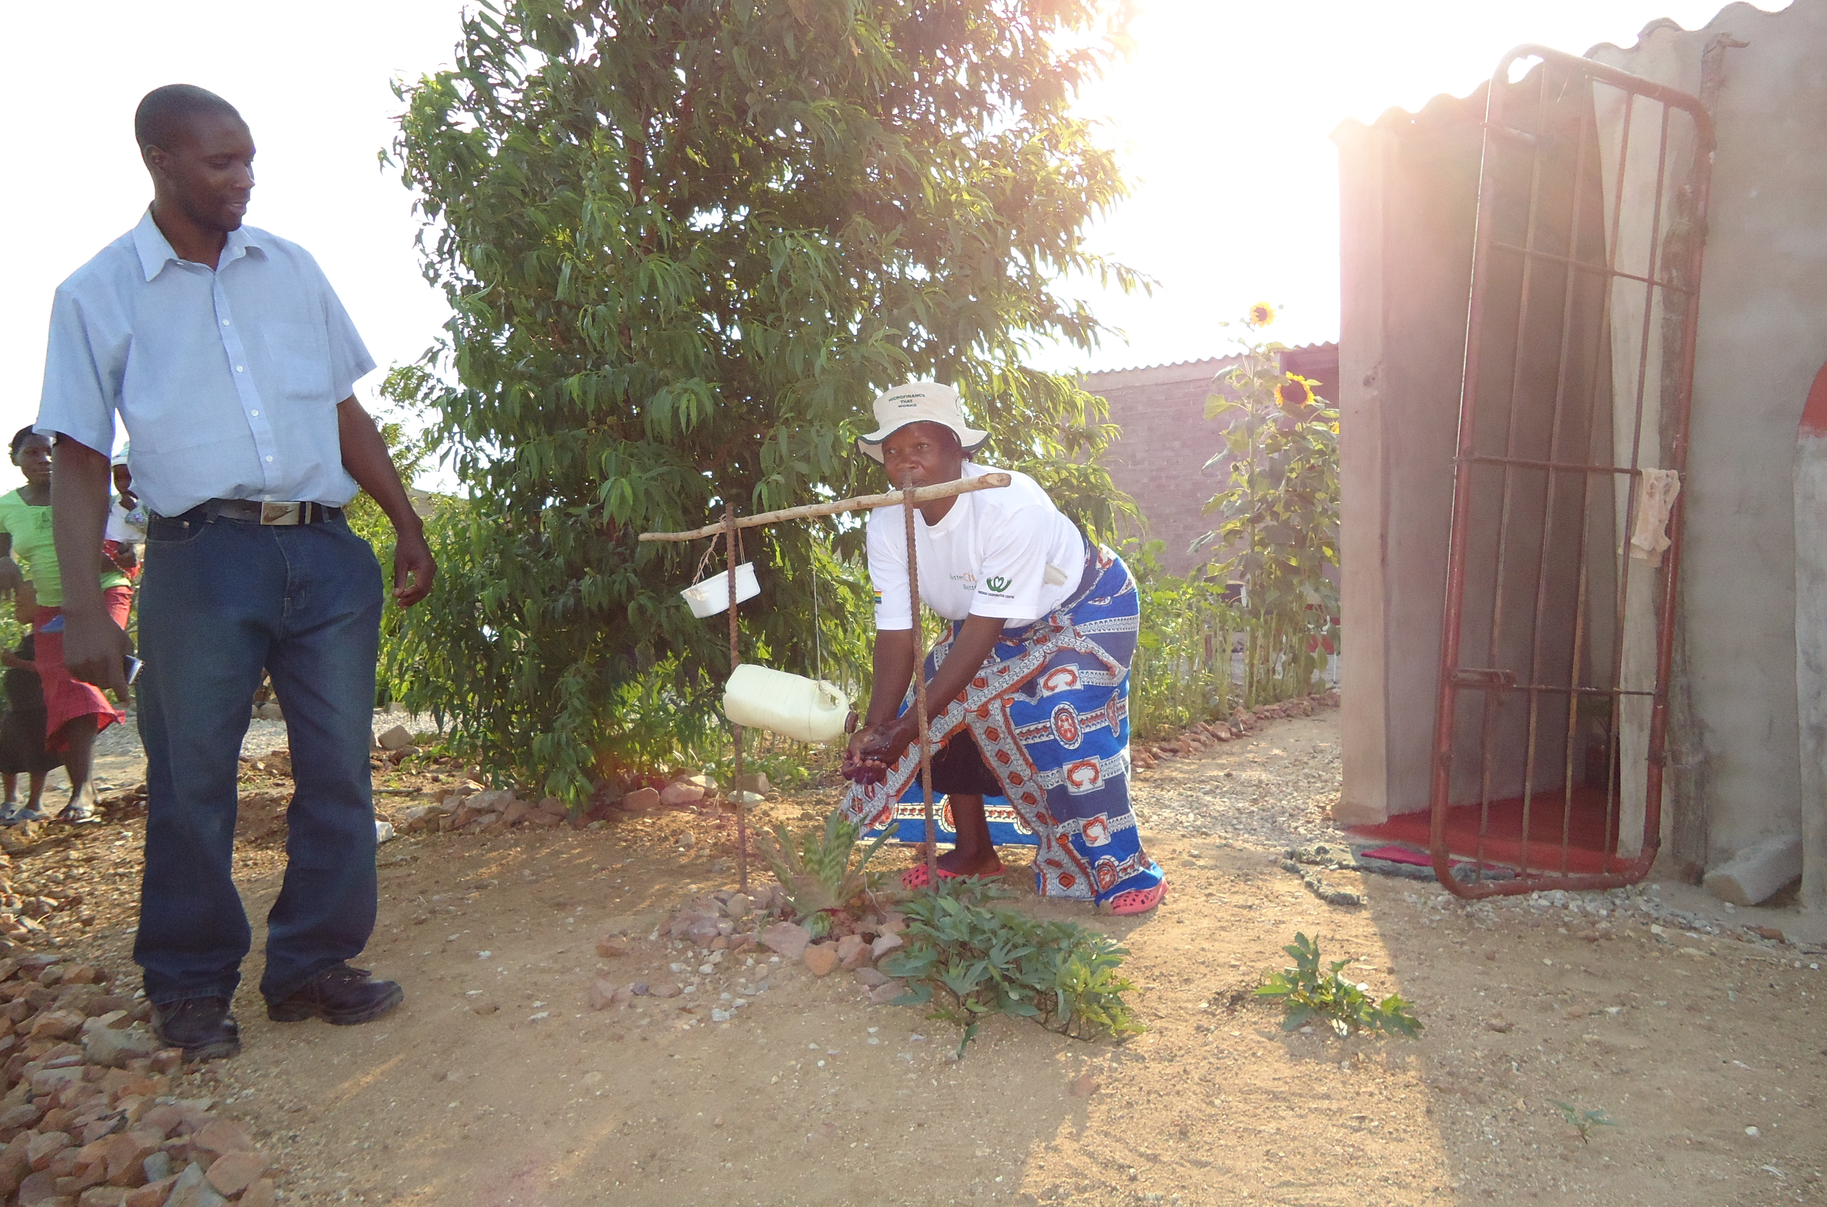
Chiredzi Town: All target surpassed -
Target of 16,000 beneficiaries, but this was surpassed to 17,045.
Within 10 months: 2,981 new pot racks
3,044 new refuse pits
2,946 Tippy Taps (90%)
617 new nutrition gardens
The project stimulated a high appreciation of sanitation as shown by the construction of 1,230 latrines without subsidies,
of which 235 were cement VIP latrines.

Slide 10
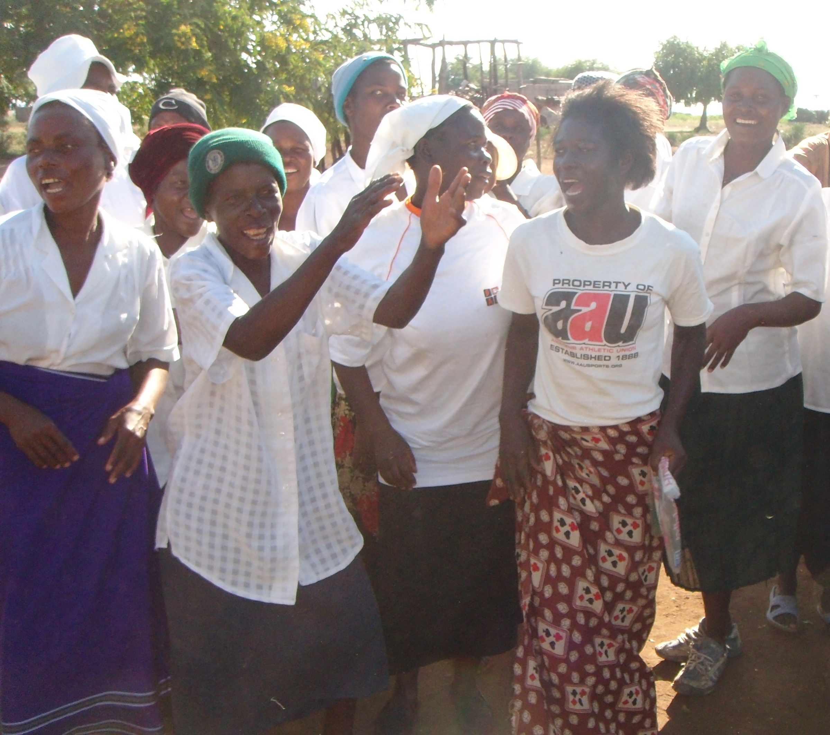
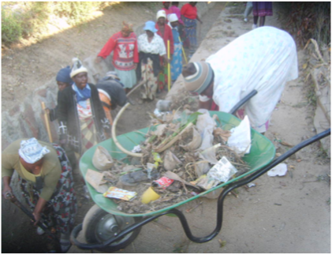
3.
Masvingo Town: Civic Pride and Responsibility
‘We people in Garikai slum now know how to survive! Those people in town they now respect us and our place is not looked down on as a dump anymore.’
‘A notable example of the new civic pride was when one CHC member noting the registration plate of a vehicle who threw litter out of their moving car and reported it to the council. The council successfully charged the driver, and a fine had to be paid!’
‘We counted that 570 Tippy taps were constructed across the town, with 220 pot racks and 260 refuse pits in the Garikai slum alone.’
Project Officer report

Slide 11
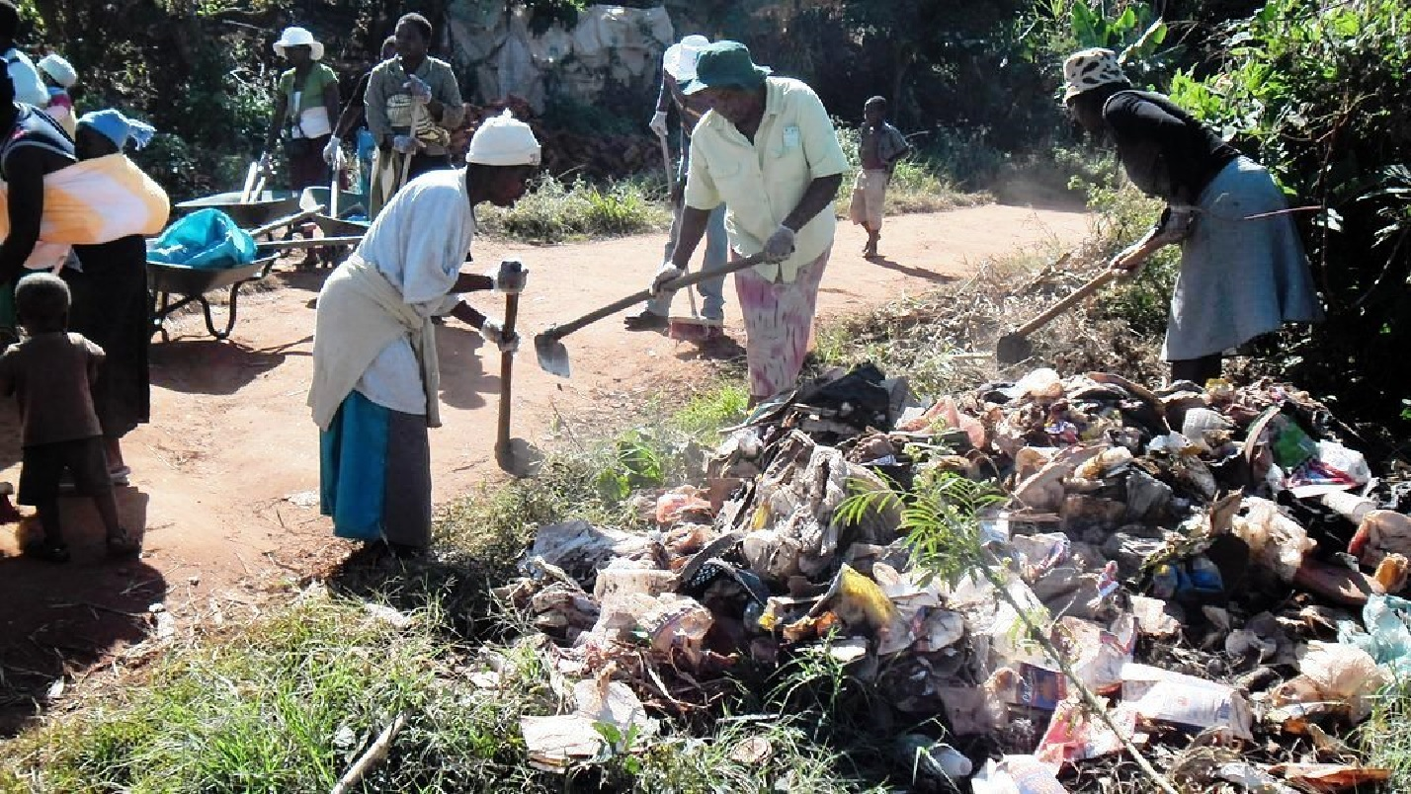
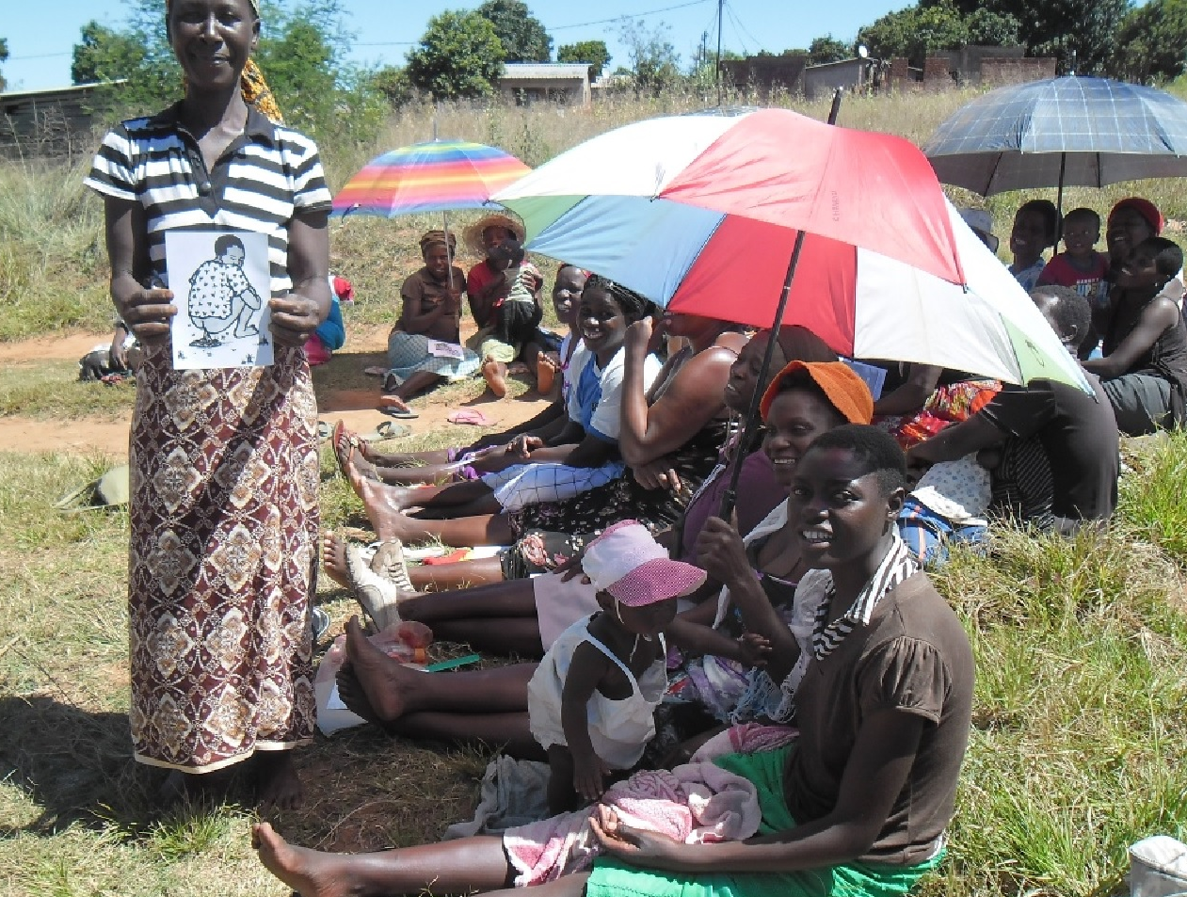
4.
Chipinge Town: Clean ups and Savings Clubs
Letter to Zim AHEAD from the Council:
‘May we take this opportunity to thank you for the wonderful work you did in the last project and for the cordial working relationship which both enjoy.’
Community Services Officer
For Chief Executive Officer
CHIPINGE DISTRICT COUNCIL
‘A highlight of this area was the initiative taken by one club who contributed money and raised funds and purchased tea cups so that each member got three cups. This is to encourage people not to share cups, but to have their own so as to stop spread of TB.’

Slide 12
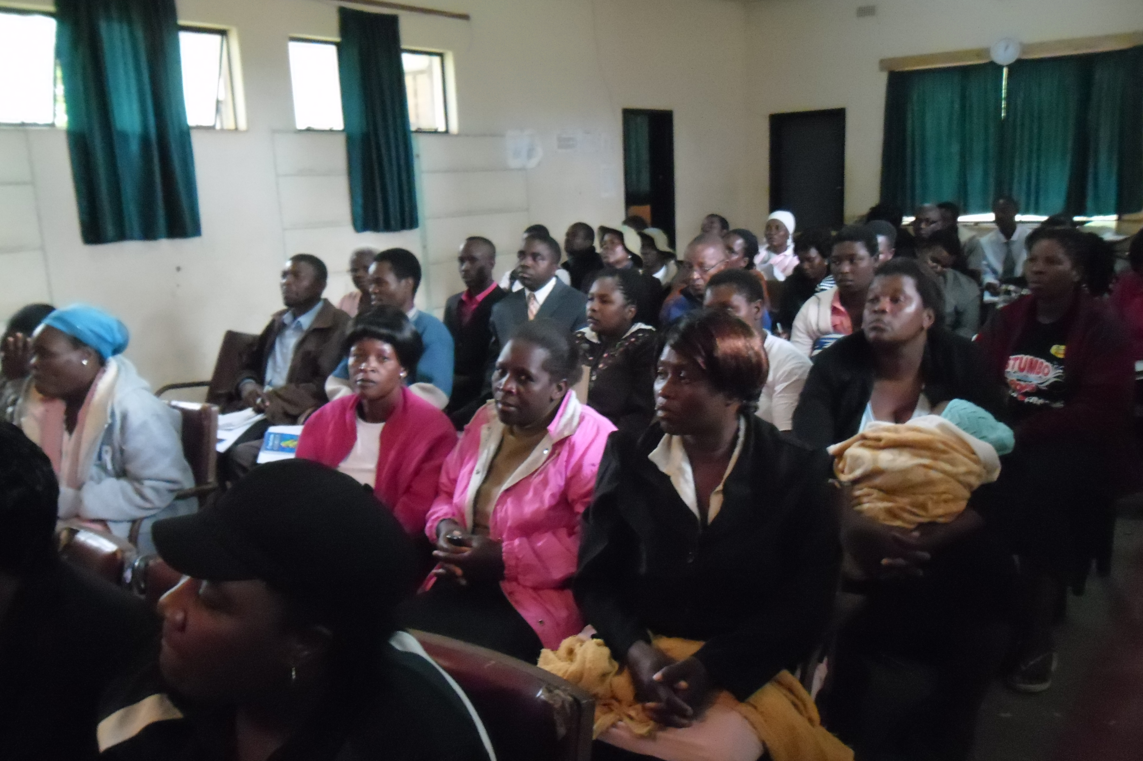
5.
Bindura Town: Repairing the bad blood between
Town council and rate payers
Bindura Town Council has begun to meet residents through the CHCs. Critical issues are discussed during the meetings. BTC has taken the project as council’s baby and not as a departmental issue. Various council departments team up when they go out to meet the residents through the CHCs.’
Project Officer
‘Broken down boreholes are being repaired through CHC initiatives. Before this project, there was bad blood between Bindura Town Council and residents. They were two worlds apart.
CHCs came at the right time because now good relations are being created.’

Slide 13
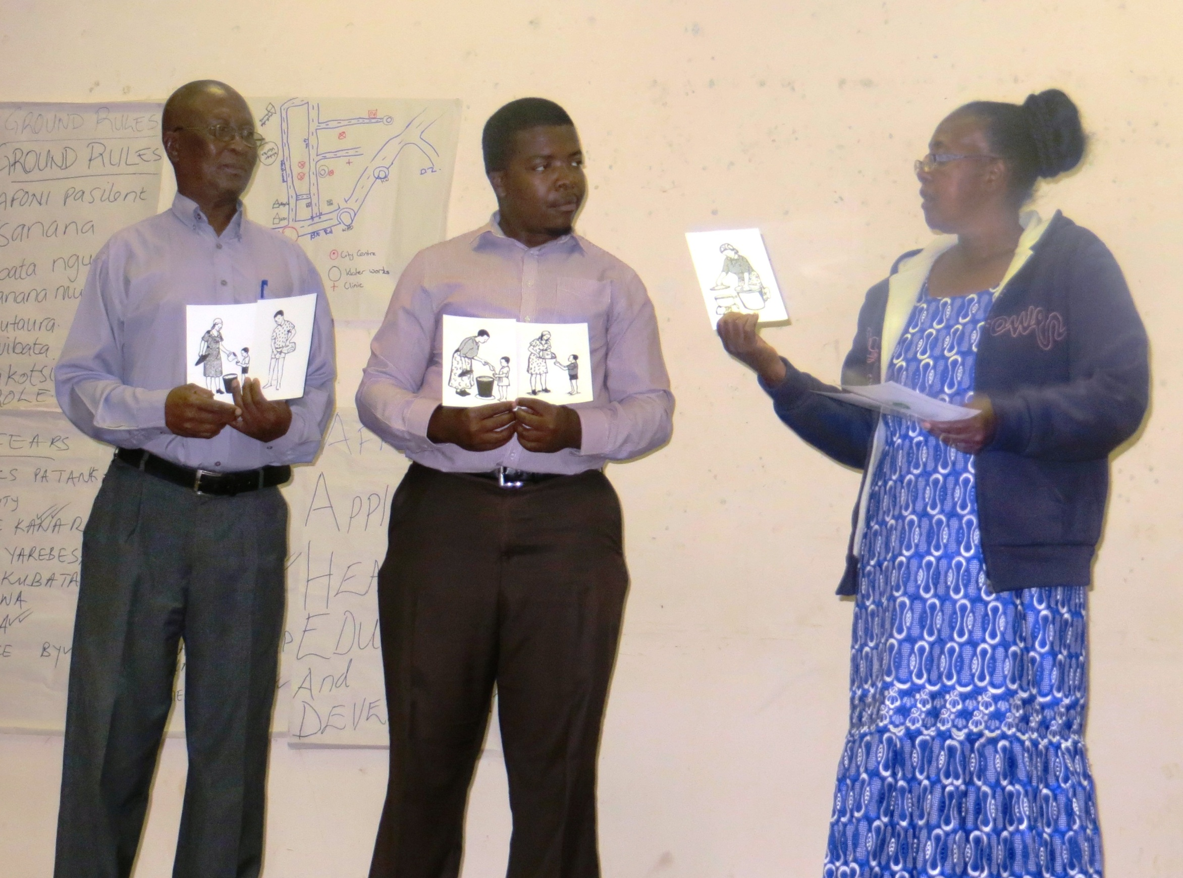
It all starts with a good Training of Trainers (CHC Facilitators)
Africa AHEAD trainers the Trainers in a 5 day workshop which enable them to start CHCs and train Community based facilitators to each start a CHC in their neighbourhood.

Slide 14
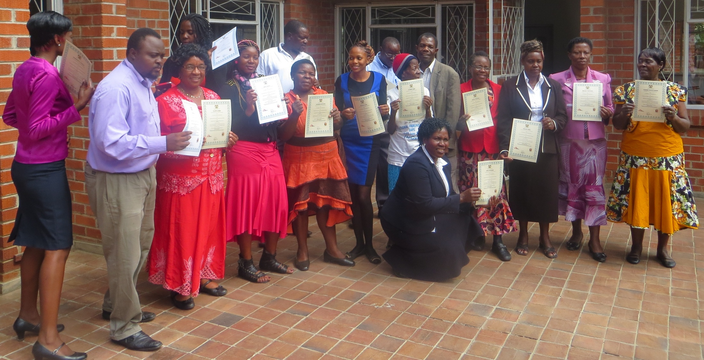
The Community Based Facilitators graduate with their supervisors

Slide 15
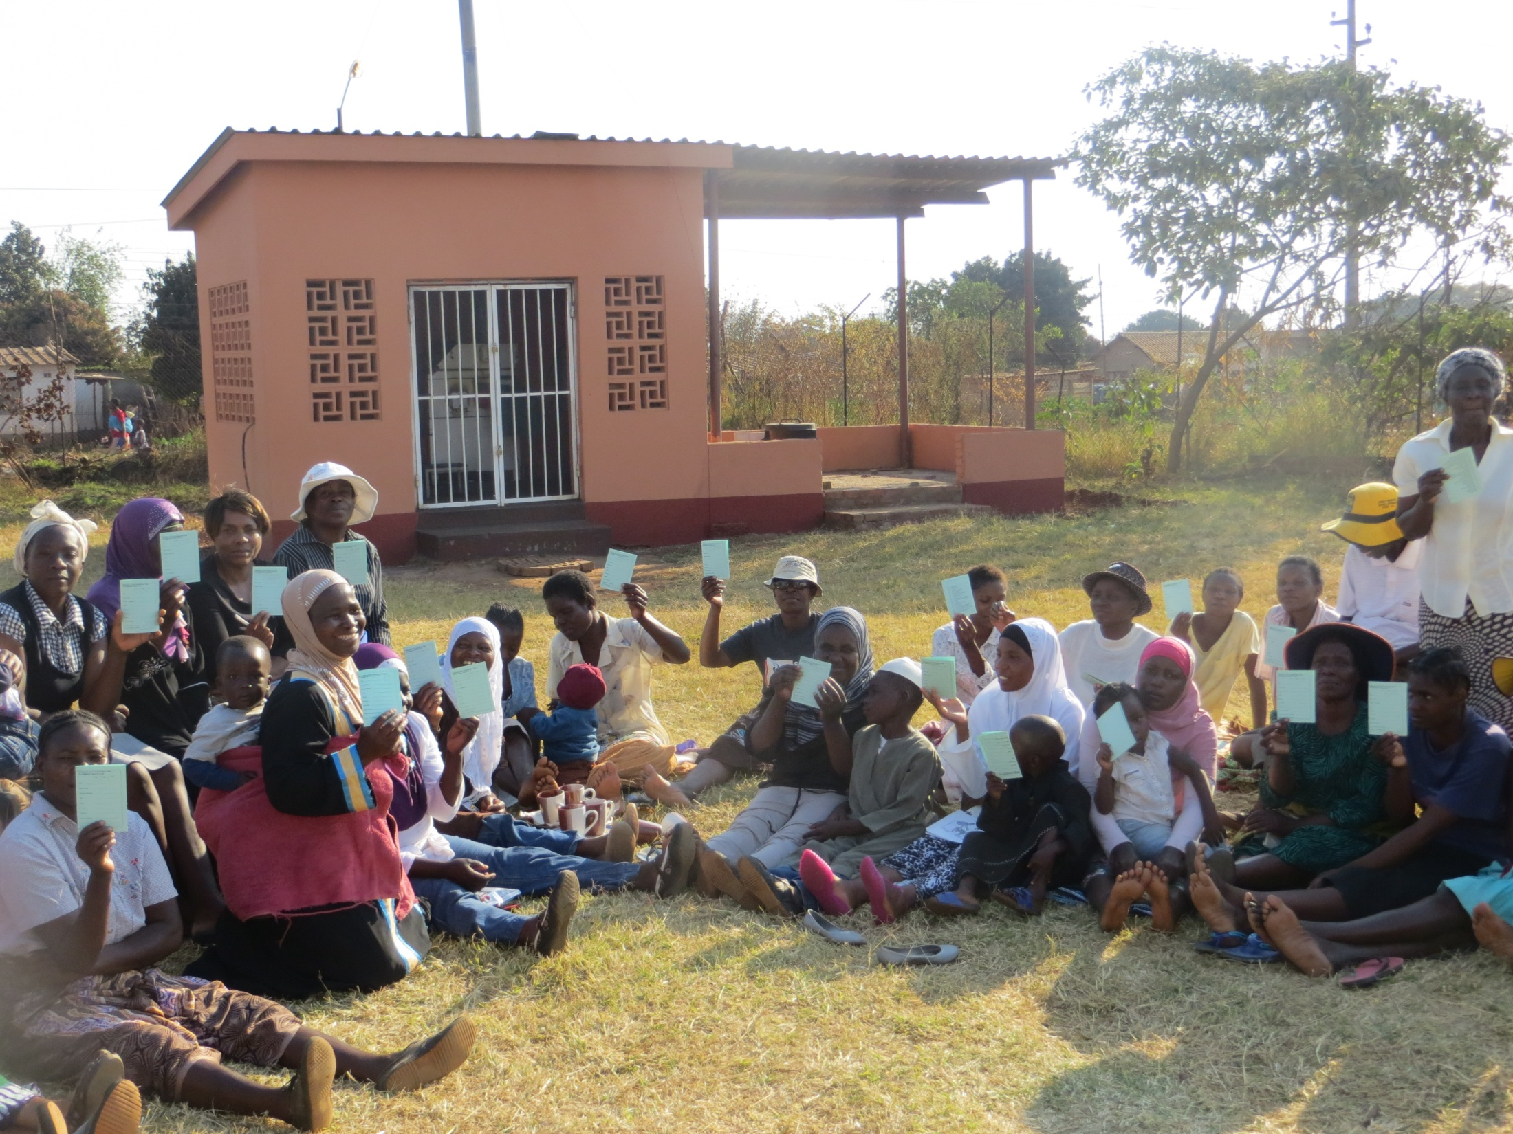
Proud Card Carrying CHC members at Rujeko Clinic Dz Harare

Slide 16
6.
Harare: Saving the capital: overcoming divisions
Developing Social Capital – Networks for survival in the Capital City where all else is failing: 85% unemployment!

Slide 17
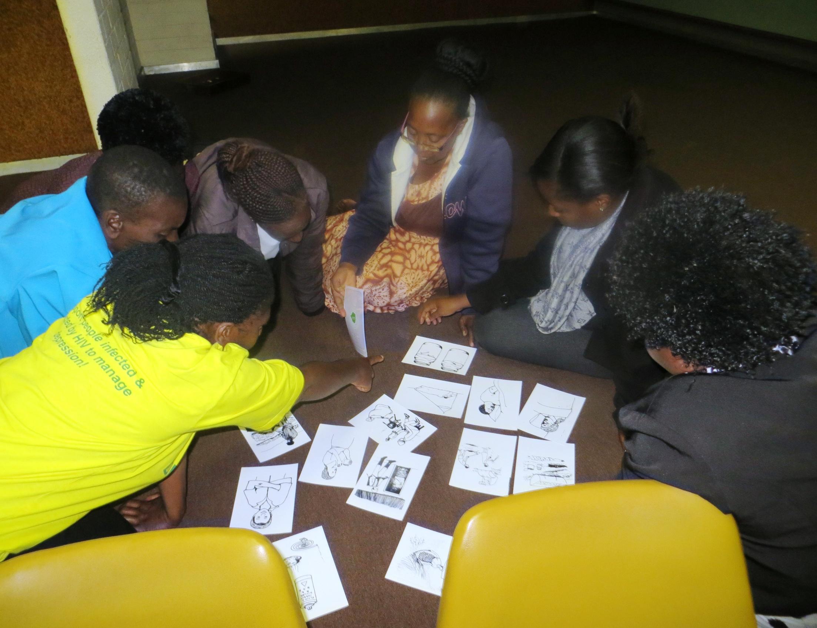
Peer Education in the CHC- people-to-people, educated or not!

Slide 18
School Health Clubs – ‘Catching them young’
School Health Clubs in every neighbourhood, complimented by Community health clubs will clean up the informal settlements, high density suburbs and create common unity in the town.

Slide 19
The ingredients for an Urban CHC:
Commitment from the Town Council
Committed Volunteers - Facilitators
A good Training of Trainers Workshop
Membership cards
Urban PHHE tool kits
Formation of CHCs
Graduation / recognition
Backstopping monitoring and evaluation
COST OF INGREDIENTS- Average of six projects:
$2.60 person / annum.

Slide 20
The Results of an Urban CHC
Increased Social Cohesion
Household Water Treatment
Self initiated clean up campaigns & sanitation
ZERO littering as waste is managed by residents
Improved service-provider to residents relations
An improved environment due to positive peer pressure
Friendly competitions for best household, best street & best community

Slide 21
Conclusion
Positive behavior change through CHCs in urban environments is not only possible but like rural areas.
Positive change comes at a small cost - less than $2.6 person/annum to change behavior for life
We saw it in Mutare, Chiredzi, Masvingo, Chipinge, Bindura and now Harare.
If you don’t believe it, come and see for yourself!

