Slide 1
UNC-CH Water and Health Conference
CLTS and CHCs – Complementary or Contradictory

Slide 2
Outline
Rehearsing CLTS – principles, potential
Motivations behind CLTS / CHC
CLTS strengths, weaknesses
CLTS experience from East Asia
Collaboration and synergy

Slide 3
Principles of CLTS approach
Outcomes focus, not hardware
Collective action @ community level; incentives directed towards community outcomes
Local choice around technology options
Communities construct their own latrines with own resources; no standardized design – innovation
Facilitation, not teaching
Notes:
Community-Led Total Sanitation (CLTS) is an approach which helps rural communities to understand and realise the negative effects of poor sanitation and empowers them to collectively find solutions to their inadequate sanitation situation. CLTS is focused on igniting a change in sanitation behaviour rather than constructing toilets. This is done by a process of social awakening that is stimulated by facilitators from within or outside the community. This approach concentrates on the entire community rather than on individual behaviours. The first significant step of CLTS is to end open defecation as an entry point while changing sanitation behaviour. It starts by enabling people to do their own sanitation profile through appraisal, observation and analysis of their practices of open defecation and the effects these have.
Focusing on outcomes, not on hardware inputs.
Collective action: Mobilising the community rather than establishing household contacts.
Local choice: Providing a variety of technological options and getting people to access affordable technologies.
Setting up proper institutional frameworks institutional framework: Giving local governments a central role in scaling up and sustainability.
Incentives: Directing incentives to the community and rewarding outcomes, rather than subsidising household toilets.
Market development: Promoting the availability of sanitary materials and allowing private suppliers to respond to the demand (see privatisation).
Communities construct their own latrines or toilets with their own resources. Those people who are better off help those who are too weak or poor to help themselves.
No standardised top-down designs: People decide for themselves.
Facilitation, not teaching or preaching: Appraisal and analysis are facilitated. But after triggering information media campaigns and encouragement can be provided.
Spontaneous emergence of Natural Leaders (NLs) as a community proceeds towards Open Defecation Free (ODF) status.
Local innovations of low cost toilet models using locally available materials.
Community-innovated systems of reward, penalty, spread and scaling-up.

Slide 4
Potential of CLTS
CLTS Potential
Speed
Totality
Social solidarity
Local leadership
Notes:
CLTS entails with it the potential for further benefits beyond those of previous partial sanitation programmes:
Speed. The speed of going total, meaning that the community is claiming to be Open Defecation Free (ODF), can be remarkable. In best-case scenarios communities declare themselves or are declared ODF in a matter of weeks.
Totality. ODF conditions provide a public and not just a private good. CLTS has shown a spotlight on this aspect. A question is to what degree achieving total or degrees of total ODF status increases these benefits for the community. Claims of dramatic drops in diarrhoeas and other diseases following the achievement of ODF conditions are numerous. People in ODF communities do again and again report sharp drops in diarrhoea and medical expenses. Anecdotal evidence is so widespread, and seems such commonsense, that it is easy to believe.
Social solidarity leading to other actions. The community solidarity and sense of achievement from a successful CLTS process can be an entry point for other initiatives. The Social Development Unit of CARE Bangladesh has pioneered here, and there have been examples of communities coming together to build embankments to prevent flooding and crop loss, following CLTS triggering and action. They have also tackled the annual hunger season in other ways, with the aim of achieving hunger-free communities.
Local leadership, self-confidence and livelihood. Linked with social solidarity, the emergence and growing confidence of local leaders ― in a CLTS context usually described as Natural Leaders (NLs) ― is often reported. This provides opportunities for people with leadership potential and can also apply pressure on the existing leadership. The voluntary work and commitment of NLs can contribute to the sustainability of CLTS and other activities beyond the life of any external project.

Slide 5
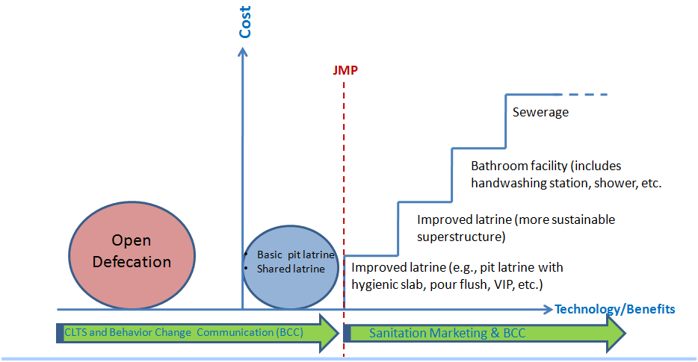
Conceptual Approach
Source: Eddy Perez, WSP
Changing Behaviors First to Stop Open Defecation
and Create Demand for Moving Up the Sanitation Ladder
India

Slide 6
Motivating Factors
CLTS
Shame
Disgust
Embarrassment
Disease prevention – cholera, diarrhea
CHCs
Achievement
Belonging
Competition
Disease prevention – cholera among others
Future income generating activities
Notes:
Contrasts
the two interventions differ considerably with respect to the scope of their intended impact. CHCs cover a broad range of health related issues through a structured, regular system of club meetings and practical activities. In contrast CLTS is an approach with a single message conveyed during a relatively small amount of contact time with the community.
Whilst CHCs apply an educational methodology where group consensus is sought through participation in health club sessions, CLTS is more confrontational, capitalising on the significance placed on respect and social relationships to elicit emotions such as shame and embarrassment, in turn galvanising a sense of community action and responsibility.
Consensus
the creation of a demand for behaviour change from within the community.

Slide 7
Strengths & Weaknesses
Strength | Weakness
No reliance on sanitation subsidies or service delivery from external agencies for hardware | Sustained behavior change?
Encourages behavior change; social awakening and self-realization | Spread in areas with prior subsidy? Narrow band of favorable pre-conditions?
Empowers community | Sustainability of CLTS hardware solutions is questionable
Empowers natural leaders and facilitators | Relies critically on quality of facilitation
CLTS

Slide 8
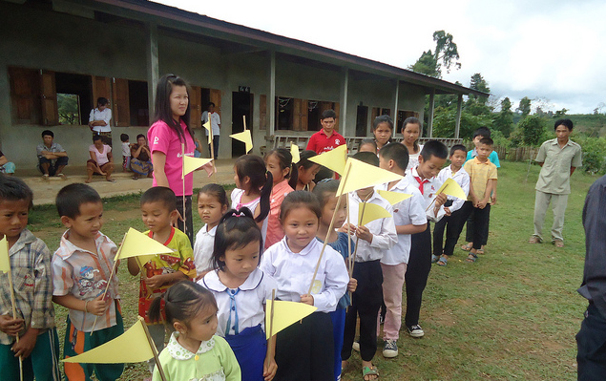
Potential for collaboration…?
CHCs address some gaps left by CLTS
Stronger emphasis on hand-washing
Sustained follow up
CLTS emphasizes community construction of latrine - missing in CHCs
Separate timing/implementation

Slide 9
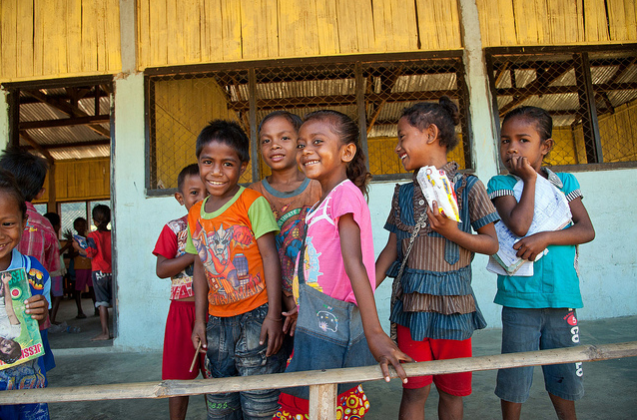
Notes:
The ‘thank you’ slide with your main contacts to end on

Slide 10
Approach Structure
Vertical – Sanitation/Open Defecation
CLTS
Horizontal – All hygiene behavior
Primary Focus- Priority preventable diseases in a community
CHC
Primary Focus – Oral fecal diseases

